Slide 1
Possible use of a Neutrino Super Beam from the European Spallation Source proton linac
Marcos DRACOS
IPHC-IN2P3/CNRS Strasbourg
(E. Baussan/IPHC, T. Ekelof/Uppsala, E. Fernandez Martinez/CERN, H. Öhman/Uppsala, N. Vassilopoulos/IPHC)

Slide 2
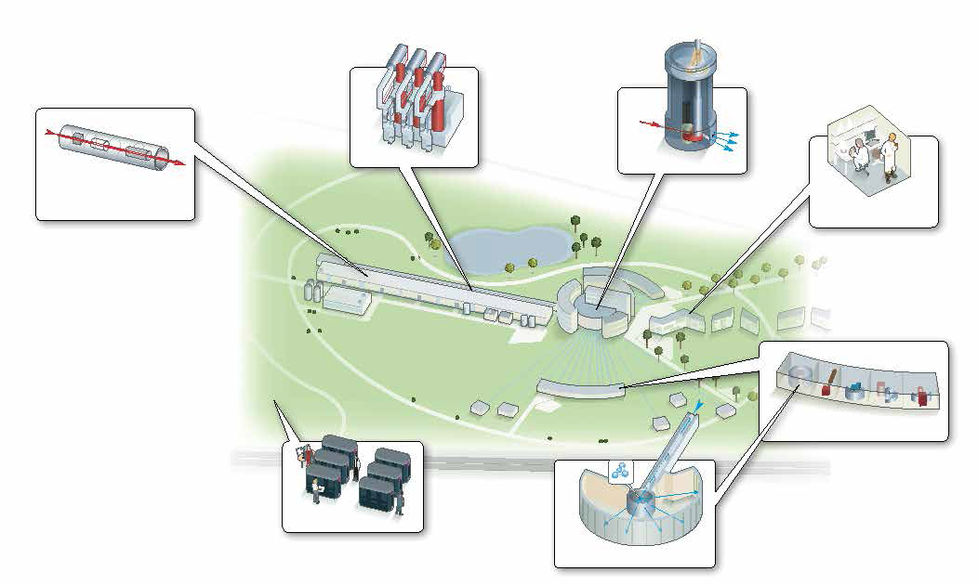
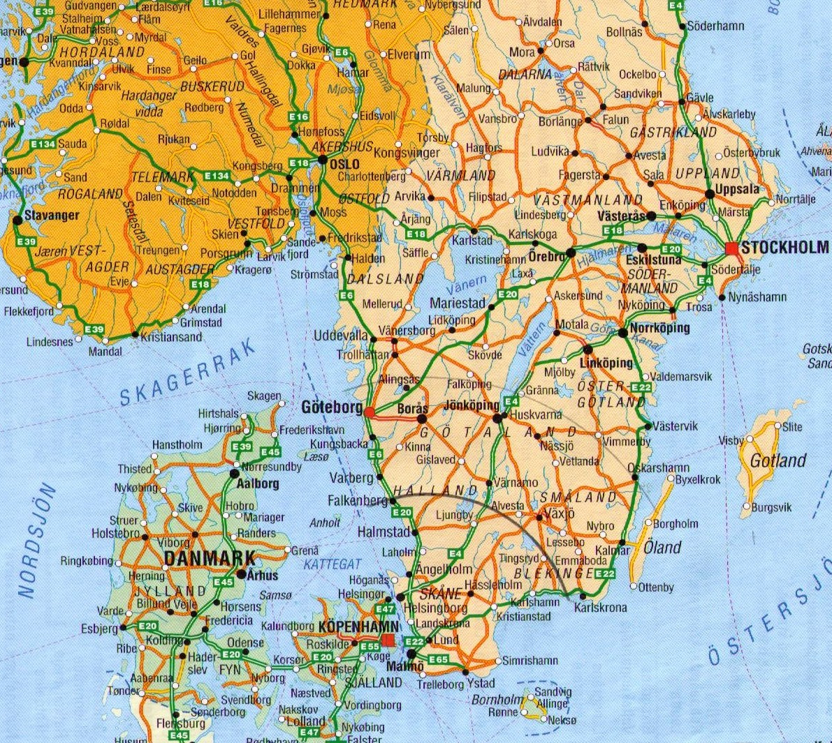
European Spallation Source (Lund)

Slide 3
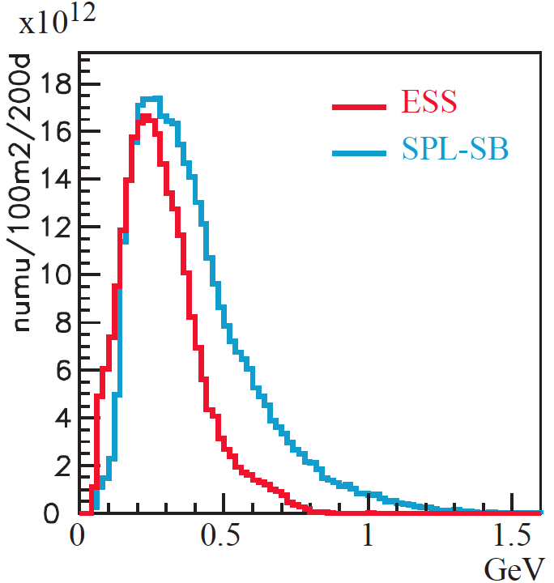
Which is the potential of the ESS project from the view of Neutrino Physics?
The ESS will be a copious source of spallation neutrons but also of neutrinos
5 MW proton beam
2.5 GeV protons
~300 MeV neutrinos
ν flux at 100 km
(EUROnu setup)

Slide 4
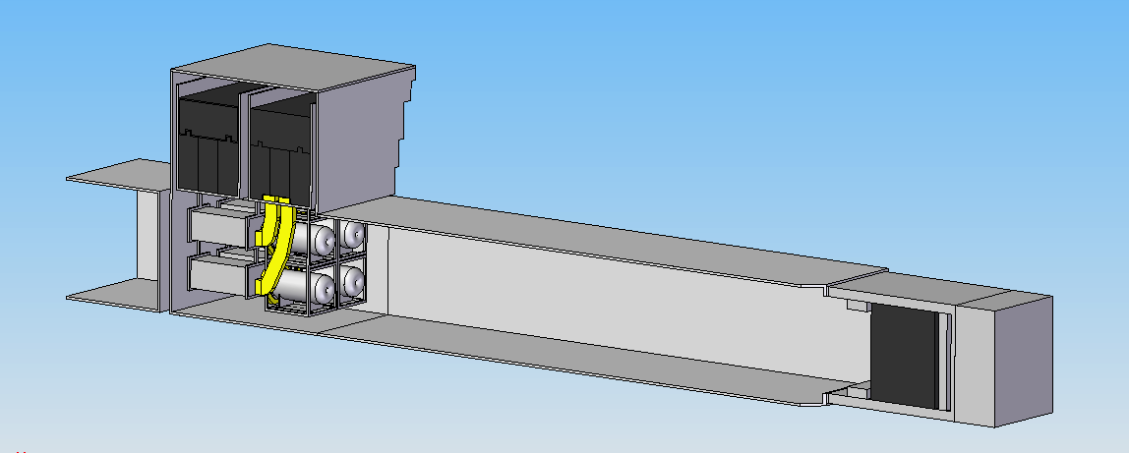
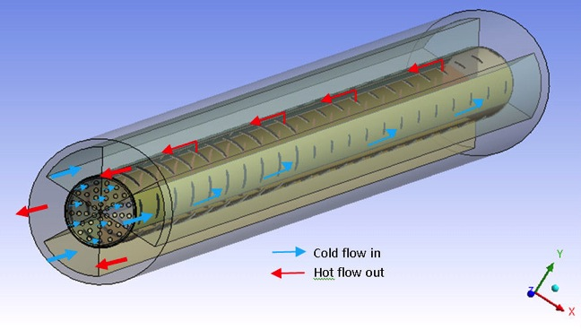
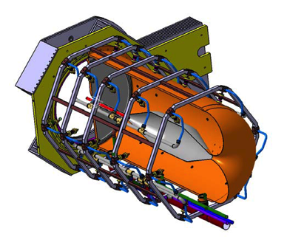
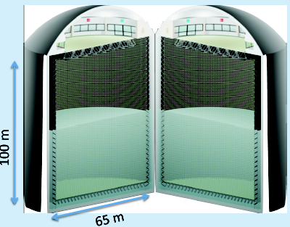
Additions to the present ESS proton linac required for the generation of such a beam
A special (thin) neutrino target with a neutrino horn (studied in detail in EUROν).
A 2.5 GeV accumulator ring to compress the 3 ms long ESS pulse to a few microseconds pulse (to reduce the cosmic ray background in the underground ν detector and current in horn).
Acceleration of H⁻ pulses in the 70 ms long empty buckets between the ESS proton 3 ms pulses (70 ms spacing is needed for the TOF measurement of the spallation neutrons) requiring more RF power generation capacity.
A very large Kton neutrino detector + a smaller near detector.
EUROν SPL-SB
MEMPHYS

Slide 5
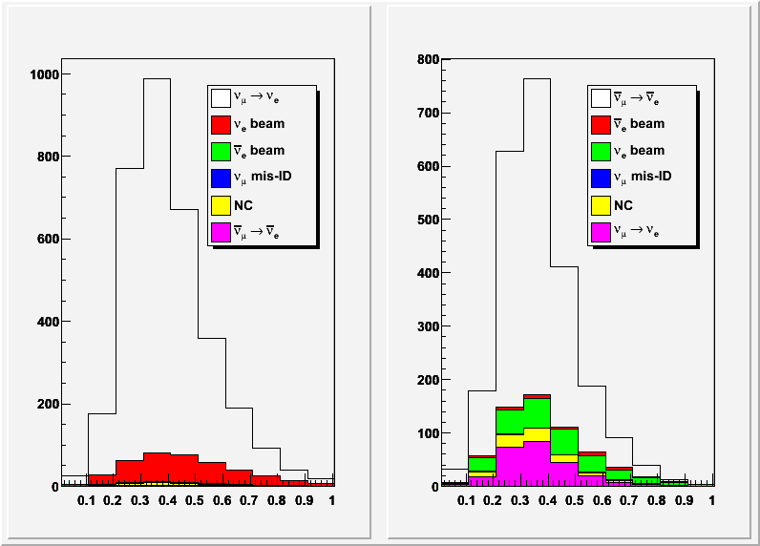
Observed neutrino spectrum
energy [GeV]
energy [GeV]

Slide 6
The MEMPHYS Project (within FP7 LAGUNA DS)
Mainly to study:
Proton Decay (GUT)
up to ~10³⁵ years lifetime
Neutrino properties and Astrophysics
Supernovae (burst + "relics")
Solar neutrinos
Atmospheric neutrinos
Geoneutrinos
neutrinos from accelerators (Super Beam, Beta Beam)
Water Cerenkov Detector with total fiducial mass: 500 kt:
2 Cylindrical modules 100x65 m
Readout: 22.2k 8” PMTs, 30% geom. cover.
(arXiv: hep-ex/0607026)

Slide 7
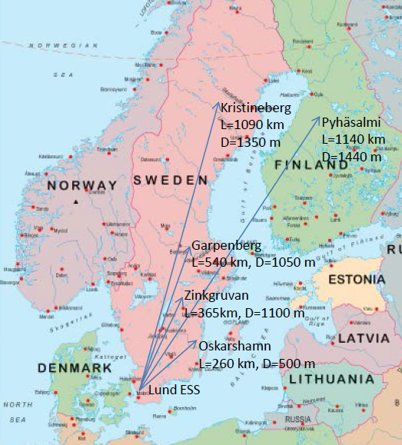
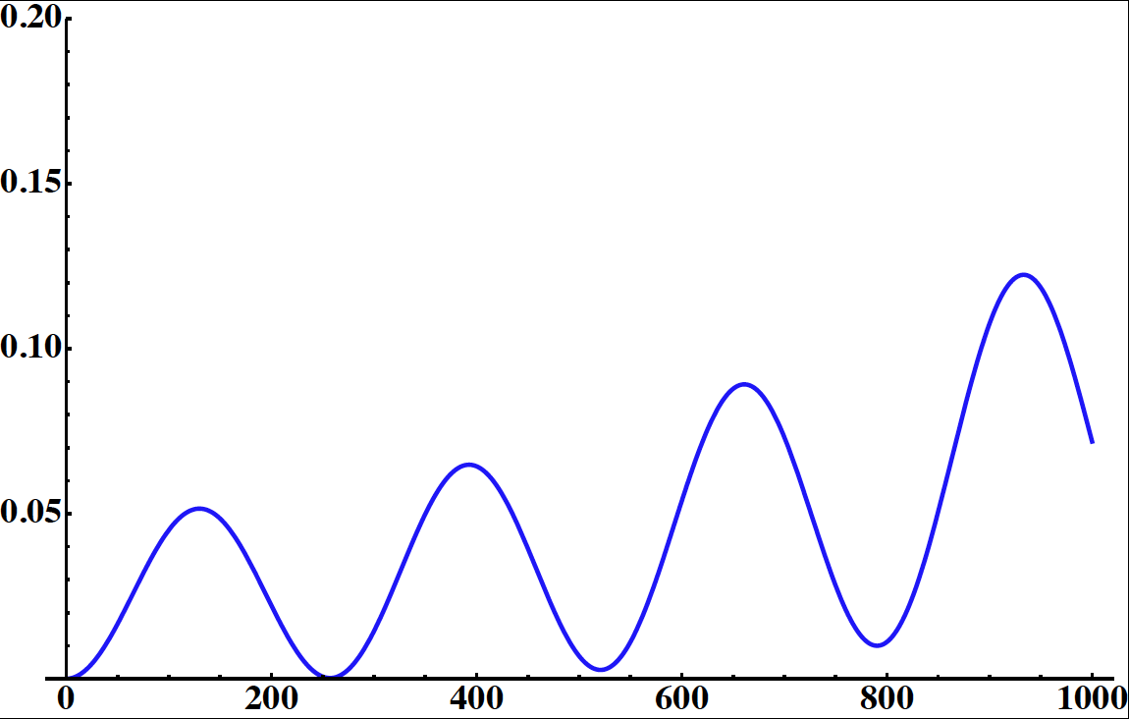
Possible Detector Locations
Many mines (active or not) are available in Sweden
What is the optimal position for CPV
How this project could help for MH?
Δm²_{sun}=7.6x10⁻⁵ eV²
Δm²_{atm}=2.5x10⁻³ eV²
θ₂₃=44.4°
θ₁₂=34.4°
θ₁₃=9.3°
δ_{CP}=0
E~290 MeV
p(ν_{μ}→ν_{e})
distance (km)

Slide 8
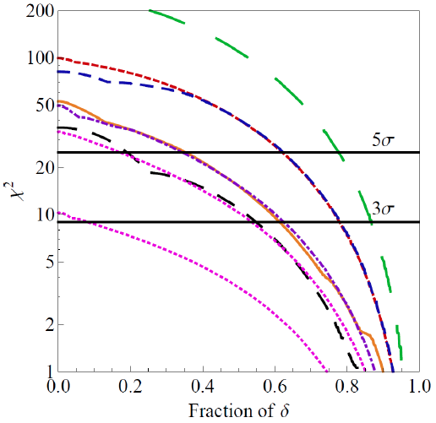
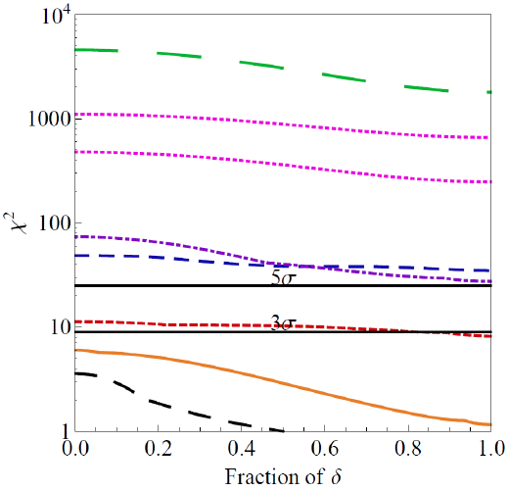
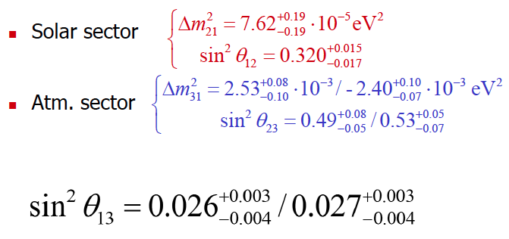
Physics Performance (Enrique Fernantez et al.)
CPV
MH
100 kt LAr
100 kt LAr
20 kt LAr
SPL: CERN to Fréjus (130 km)
CF-1st: CERN to Canfranc (650 km) 1st max.
CF-2nd: CERN to Canfranc 2nd max.
1 Mton WC detector (440 kton fiducial), 5% syst.

Slide 9
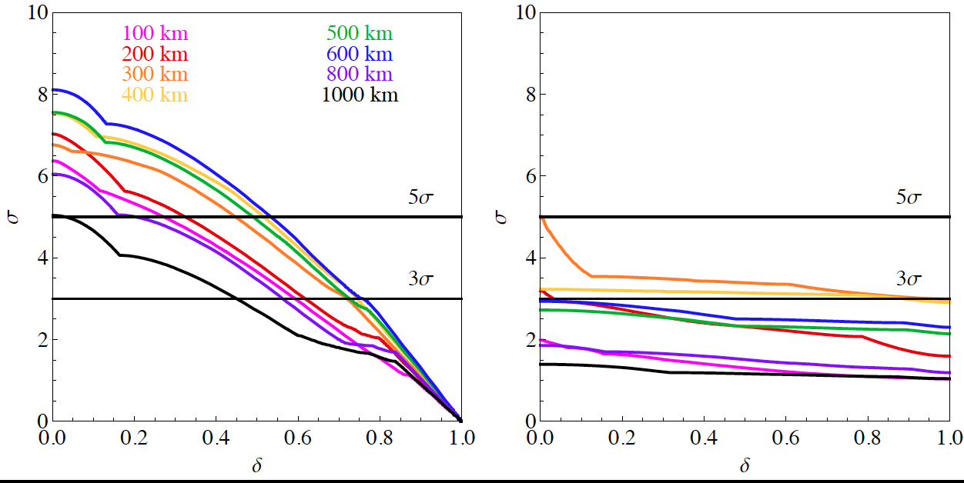
Physics Performance using ESS beam
CPV
MH
without adding yet atmospheric neutrinos (optimization is needed)
Very preliminary
Very preliminary
fraction
fraction
EUROν parameters without any particular optimization
1 Mton WC detector (440 kton fiducial), 5% syst.
2.5 GeV protons
5 MW proton beam
2 years neutrinos + 8 years antineutrinos

Slide 10
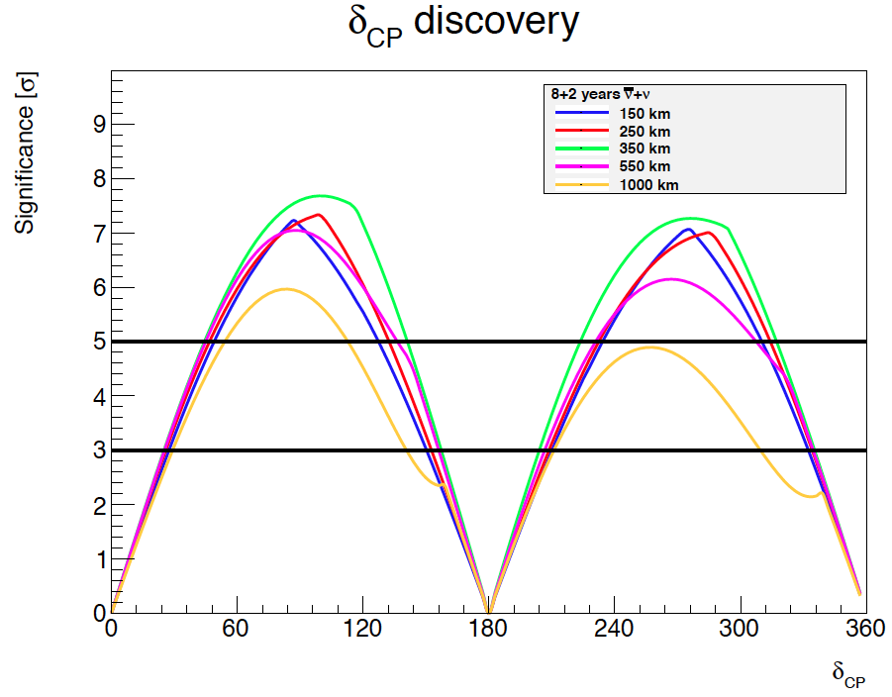
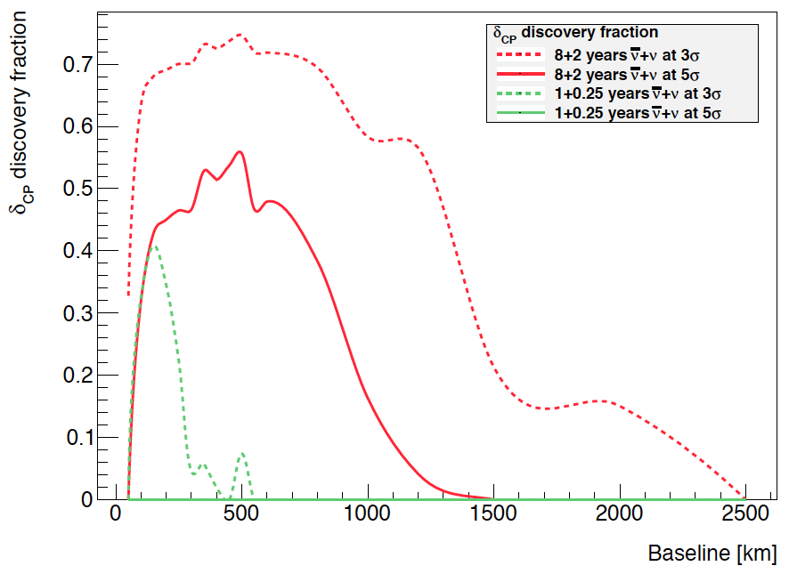
Physics Performance using ESS beam
Very preliminary
Very preliminary
EUROν parameters without any particular optimization
1 Mton WC detector (440 kton fiducial), 5% syst.
2.5 GeV protons
5 MW proton beam
2 years neutrinos + 8 years antineutrinos

Slide 11
Conclusion
The ESS proton linac has great potential as generator of the most intense neutrino beam in the world during the coming decades.
Such a beam, in combination with a large underground Water Cherenkov detector, would make possible the discovery and measurement of neutrino CP violation.
Preliminary results show that for CPV, ~75% of δ can be covered for 3σ discovery and ~53% for 5σ.
Future work will aim at determining the optimal parameters of the beam line, in particular the decay tunnel length and diameter, the horn shape and current and the longitudinal position of the target inside the horn as a function of the base line (location of the far detector).
The sensitivity to Mass Hierarchy has also to be optimised and also take into account atmospheric neutrinos (one order of magnitude more compared to SuperK).
The large underground Water Cherenkov detector would also be used for high precision measurements of solar and supernovae neutrinos as well as to search for proton decay.
The results we have today are preliminary and we will have to work further to be able to draw firm conclusions on which base-line distance is the optimal one.

Slide 12
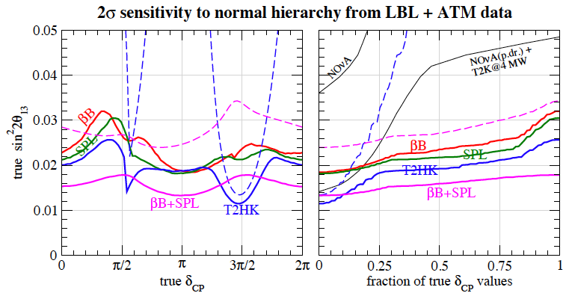
Sensitivity to mass Hierarchy?
solid line: LBL+atm.
dashed line: LBL
BB: 5 ν+5 anti-ν years
SB: 2 ν+8 anti-ν years
arXiv:hep-ph/0603172v3

Slide 13
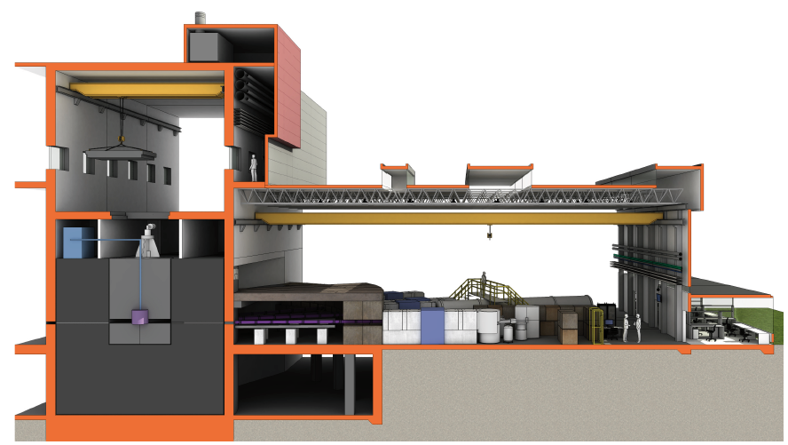
European Spallation Source

