Slide 1
MICE Step 1: First measurement of emittance with particle physics detectors
1/20
V. Blackmore, University of Oxford,
on behalf of the MICE Collaboration

Slide 2
About MICE
2/20
Ionisation cooling
The Muon Ionisation Cooling Experiment (MICE)
The beam line

Slide 3
Ionisation Cooling
3/20
$$β_{t}$$
$$μ$$
$∎$Cooling: reduction of the beam volume in 2, 4, or 6 dimensional phase space.
$∎$ Light-to-moderate 4D cooling required for Neutrino Factory.
$∎$ Intense 6D cooling required for Muon Collider.
$∎$ Begin with ionisation cooling.
$$β_{t}$$
RF
Require small $β_{t}$ at absorber → tight focus $\vec{B}$ field
Absorber
Restores only longitudinal momentum
Reduces all momentum components
$\left\{x,p_{x}\right\}$, $\left\{y,p_{y}\right\}$ phase space reduced
Minimise
Cooling
Heating (Mult. Scat)
$$\frac{dε_{n}}{dX} ≈ \frac{{−ε}_{n}}{β^{2}E}\left\langle \frac{dE}{dX}\right\rangle + \frac{{β_{t}\left(0.014 \text{GeV}\right)}^{2}}{{2β}^{3}{Em}_{μ}X_{0}}$$

Slide 4
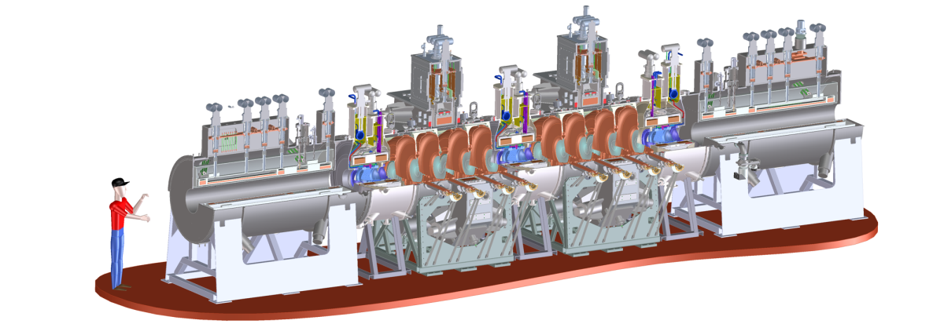
The Muon Ionisation Cooling Experiment (MICE)
4/20
Measure
Cool
Measure
$∎$In construction at Rutherford Appleton Laboratory, UK.
$∎$Full cell of ionisation cooling lattice.
$∎$Test performance in different operational modes.
$∎$Require relative precision of $\frac{∆ε_{n}}{ε_{n}}\sim 1\%$ → use particle physics detectors.
$∎$Muon-by-muon measurement.
RF
Absorber
Reaccelerates muon, restoring lost energy
Spectrometer Solenoid
Liquid hydrogen or solid Lithium Hydride.
Reduces muon momentum vector
4T Solenoid containing scintillating fibre tracker. Measures muon components: $\{x, y, z, p_{x},p_{y}\}$

Slide 5
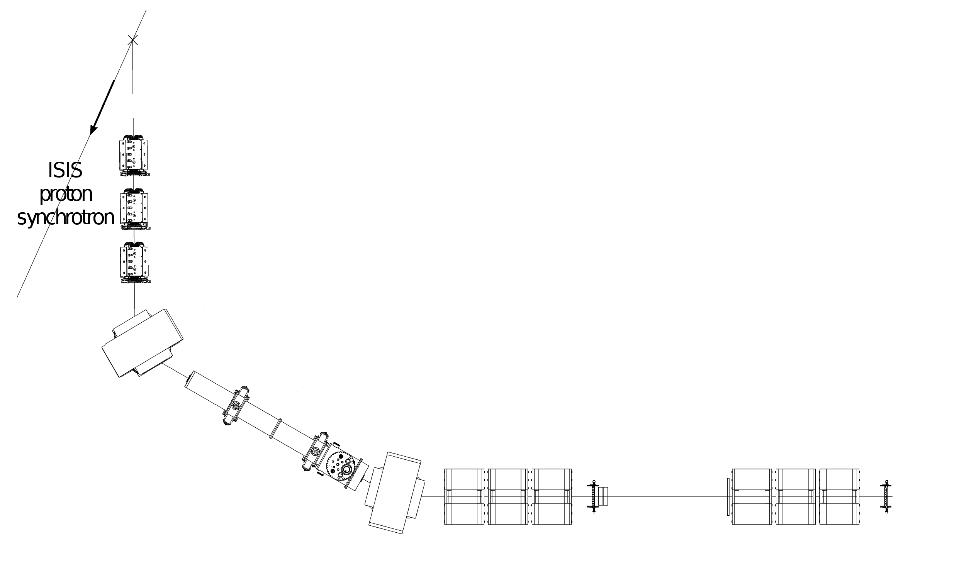
The Beam Line
5/20
$∎$Target samples 600 – 800 MeV protons, creating $π$’s.
$∎$Transported to Decay Solenoid: $π→μ+υ_{μ}$.
$∎$Can tune upstream and downstream sections independently.
$∎$Downstream section provides optically matched beam for cooling channel.
$∎$Feb. 2010: Measured beam at TOF0 and TOF1 – What have we learned?
800 MeV Protons
x
Target
Quadrupole
Triplet
Upstream
Downstream
Dipole #1
Dipole #2
TOF0
BPM
TOF1
Decay
Solenoid
Cooling Channel
Quadrupole
Triplet
Ckov
Quadrupole
Triplet

Slide 6
Emittance & Momentum Reconstruction
6/20
The Time Of Flight (TOF) system
Measuring position components
Reconstruction of muon paths
Accuracy of the reconstruction technique

Slide 7
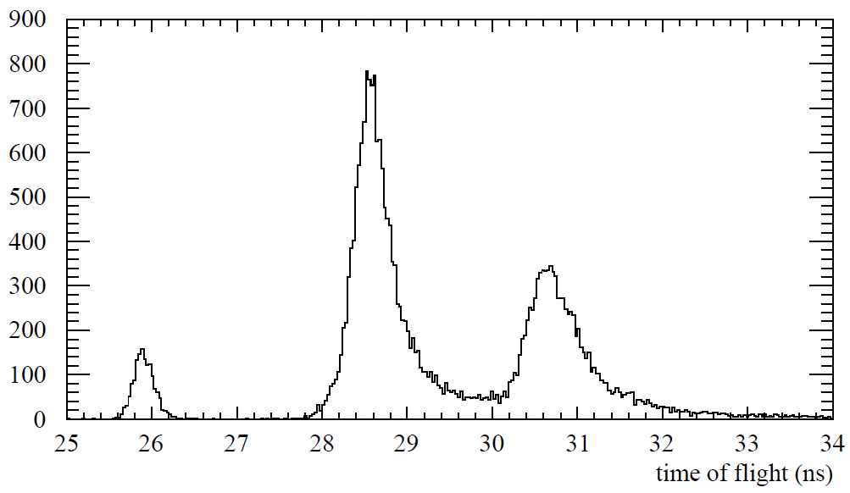
The Time Of Flight (TOF) System
7/20
TOF0
TOF1
$$z$$
Ckov
BPM
Q7
Q8
Q9
$∎$Two detectors, each with two orthogonal planes of scintillator slabs.
$∎$Measure particle crossing time to 50 ps
$∎$Dipole selects mean momentum of beam.
$∎$Time-of-flight depends on particle mass – PID possible.
$$L=7.71 \text{m}$$
$$μ$$
$$π$$
$$e$$
$$t=\left(\frac{L}{c}\right)\sqrt{1+\frac{{(mc)}^{2}}{p^{2}}}$$

Slide 8
Measuring Position Components
8/20
$∎$For each particle crossing the TOF stations, we know $\left\{x, y, t\right\}$
$∎$To learn more about the beam line we must also know $\left\{x^{′},y^{′}, p_{z}\right\}$, where $x^{′}=\frac{p_{x}}{p_{z}}$ etc.
$∎$Reconstruct particle trajectories.
$$μ$$
*
$∎$Two independent methods of measuring position:
1) Measure pixel position,
2) Measure position according to signal arrival time at PMTs.
$∎$Position resolution, TOF0: 9.8 mm
TOF1: 11.4 mm
$$x=\frac{c_{\text{eff}}\left(t_{L}−t_{R}+Δ\right)}{2}$$
$$x$$
x
$$t_{L}$$
$$x=0$$
$$t_{R}$$
$$μ$$

Slide 9
Reconstructing Muon Paths
(Thesis link)
9/20
TOF0
$δs$, excess path length
TOF1
$$z$$
$$μ$$
$$μ$$
Ckov
BPM
Q7
Q8
Q9
$∎$Begin with position measurements of muon at TOF0 and TOF1.
$∎{ \underline{M}}_{x}$ and ${\underline{M}}_{y}$ vary quickly at low $p_{z}$.
$$L=7.71 \text{m}$$
$$\left\{x_{0}, y_{0}, t_{0}\right\}$$
$$\left\{x_{1}, y_{1}, t_{1}\right\}$$
Calculate $p_{z}$ from time of flight.
Assume linear beam transport*:
Track through quadrupoles to calculate $δs,$
*$\underline{M}$ depends on $p_{z}$
Repeat
$$\left(\begin{matrix}x_{1} \\ {x_{1}}^{′}\end{matrix}\right)=\left(\begin{matrix}M_{11} & M_{12} \\ M_{12} & M_{22}\end{matrix}\right)\left(\begin{matrix}x_{0} \\ {x_{0}}^{′}\end{matrix}\right)$$
$$\left(\begin{matrix}{x_{0}}^{′} \\ {x_{1}}^{′}\end{matrix}\right)=\frac{1}{M_{12}}\left(\begin{matrix}−M_{11} & 1 \\ −1 & M_{22}\end{matrix}\right)\left(\begin{matrix}x_{0} \\ x_{1}\end{matrix}\right)$$
$∎$Correct for energy lost between TOF0 and TOF1
$${\underline{M}}_{x}={\underline{O}}_{Q9→TOF1}{ \underline{F}}_{Q9} {\underline{O}}_{Q8→Q9}{ \underline{D}}_{Q8} {\underline{O}}_{Q7→Q8}{ \underline{F}}_{Q7} {\underline{O}}_{TOF0→Q7}$$

Slide 10
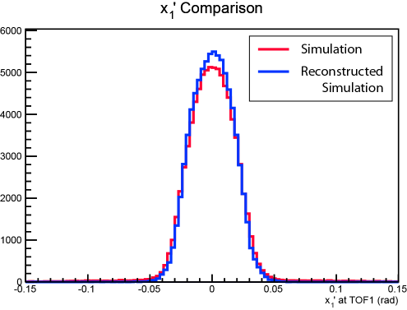
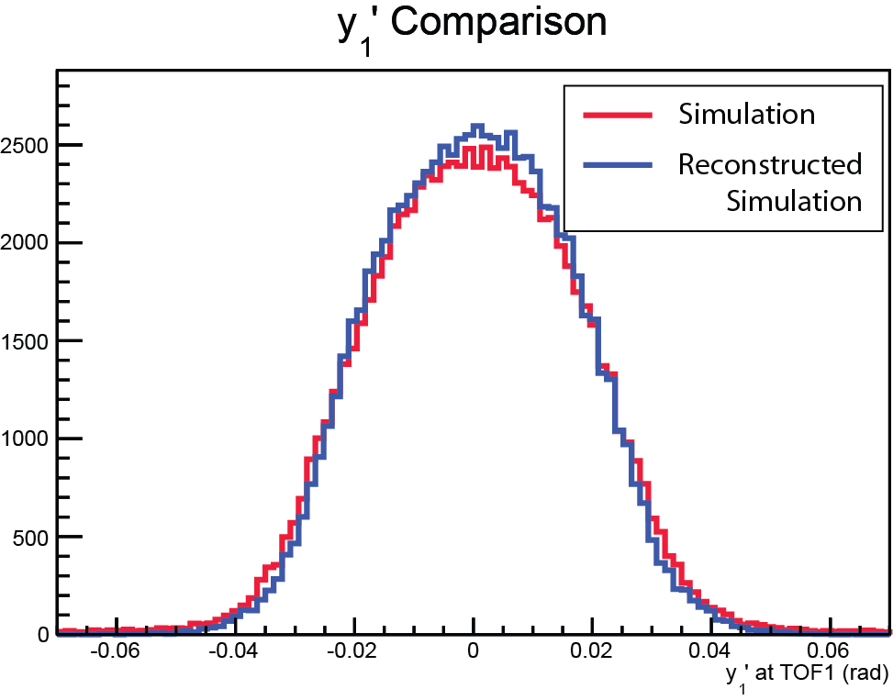
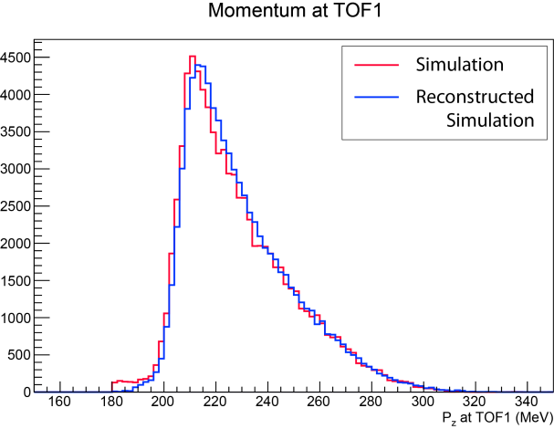
Accuracy of Reconstruction Technique
10/20
$∎ (x,y,t)$ from Monte Carlo (G4beamline, G4MICE) simulation are smeared by the TOF resolution.
$∎$Trace-space components and momentum reconstructed.
Simulation
Reconstructed
Simulation

Slide 11
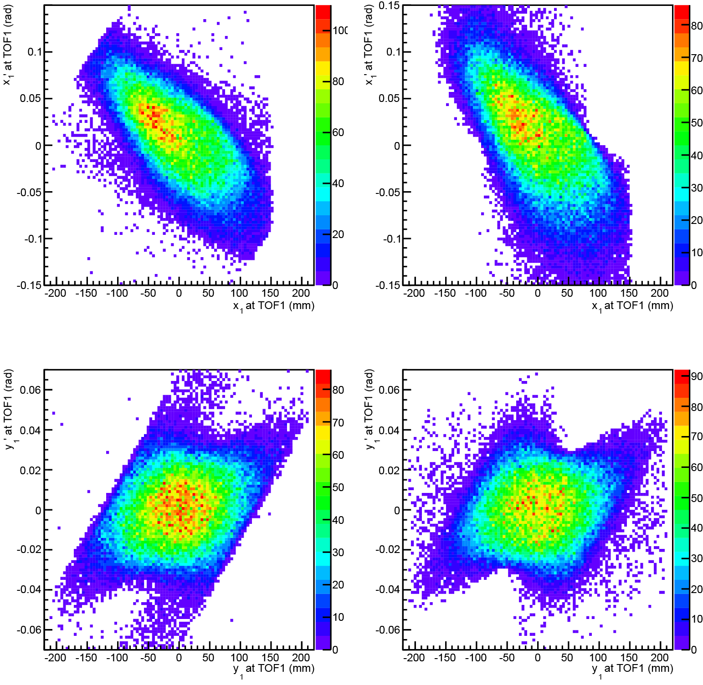
Accuracy of Reconstruction Technique
11/20
Simulation
Reconstructed Simulation
$∎ (x,y,t)$ from Monte Carlo (G4beamline, G4MICE) simulation are smeared by the TOF resolution.
$∎$Trace-space components and momentum reconstructed.
$∎$Good qualitative agreement:
$∎$Core reproduced well.
$∎$Good reproduction of high amplitude particles.
Horizontal trace space
Vertical trace space

Slide 12
Step 1 Data
12/20
Step I data sets
Expectations versus reality

Slide 13
Step 1 Data Sets
13/20
 | $p_{z}=140$MeV | $p_{z}=200$MeV | $p_{z}=240$MeV
$ε_{N}=3$ mm | $D=0$ mm | $D=0$ mm | $D=0$ mm
$ε_{N}=6$ mm | $D=5.0$ mm | $D=7.5$ mm | $D=7.5$ mm
$ε_{N}=10$ mm | $D=10$ mm | $D=15.5$ mm | $D=15.5$ mm
$∎$ MICE investigates cooling potential of lattice cell for different beam settings.
$∎$Categorise beam settings by their values at the centre of an absorber.
$∎$Nominal test beams given in an “emittance-momentum” matrix.
$∎$9 beam settings x 2 muon polarities = 18 beams [17 measured].
Thickness of Pb required to achieve this emittance and momentum upstream of cooling channel (“diffuser”)
Complication: Our beam line measurements exist upstream of the diffuser: higher momentum and lower emittance.
TOF0
TOF1
$$z$$
To diffuser
Ckov
BPM
Q7
Q8
Q9
$$L=7.71 \text{m}$$

Slide 14
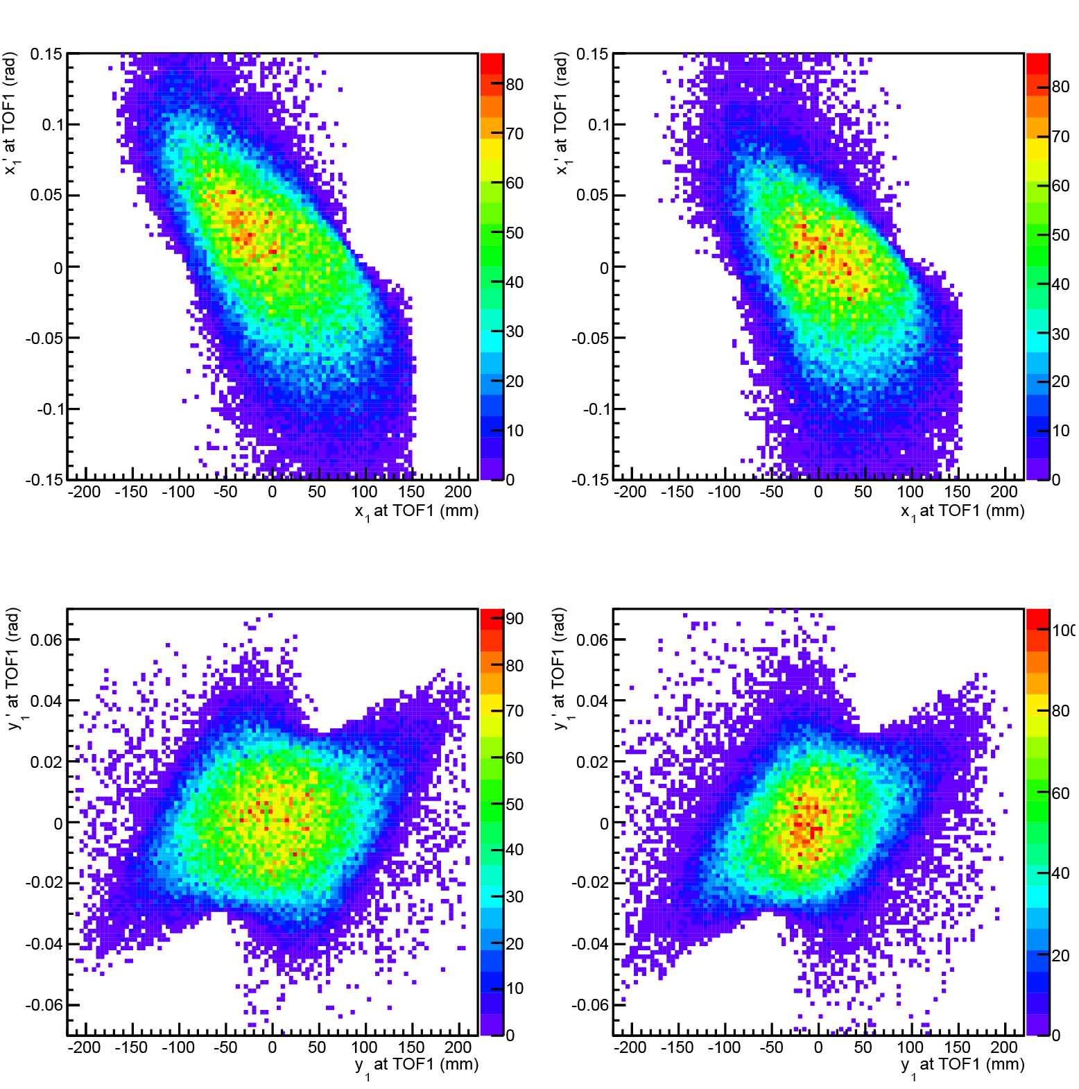
Expectation versus Reality
14/20
Reconstructed Simulation
Data
$∎$ Compare data to reconstructed simulation.
$∎$Overall good qualitative agreement.
Horizontal trace space
Vertical trace space

Slide 15
Expectation versus Reality
15/20
Reconstructed
Simulation
Data
$$μ^{−}$$
$$μ^{+}$$
$∎$ Compare data to reconstructed simulation.
$∎$Overall good qualitative agreement.
$∎$Larger difference in horizontal plane
Horizontal
Vertical

Slide 16
The Full Data Set
16/20
Reconstructed
Simulation
‘3’ mm
‘6’ mm
’10’ mm
$$μ^{−}$$
$∎$ Measured, and reconstructed emittances of 17 of the beam line settings.
$∎$Note: The nominal ‘3’, ‘6’ and ’10’ mm emittance is after the diffuser.
$∎$Good agreement with simulation.
$$μ^{+}$$
Horizontal
Vertical

Slide 17
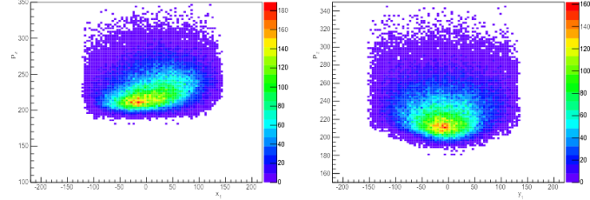
Summary
17/20
Reconstructed
Simulation
‘3’ mm
‘6’ mm
’10’ mm
$$(x, p_{z})$$
$$(y, p_{z})$$
$$μ^{−}$$
$∎$ Constant vertical emittance of 0.8 mm.
$∎$Horizontal emittance varies depending on dispersion from D2, ~2.5 mm.
$∎$Resolution of reconstruction method has not been removed.
$∎$Beam is asymmetric in $x$ and $y$.
$∎$Limited by quadrupole apertures.
$$μ^{+}$$
Horizontal
Vertical
What would happen if we put our measured muons through a simulation of the full cooling channel?

Slide 18
Evolution through Step VI
18/20
Expected performance of the cooling channel
Conclusions

Slide 19
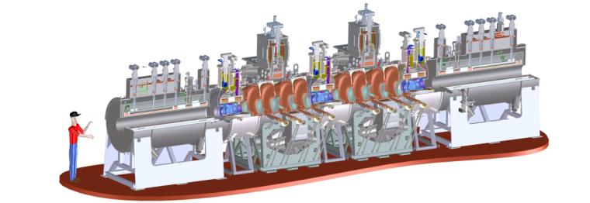
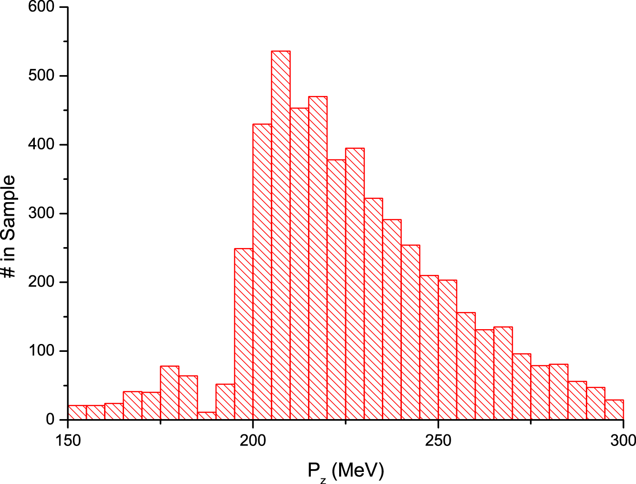
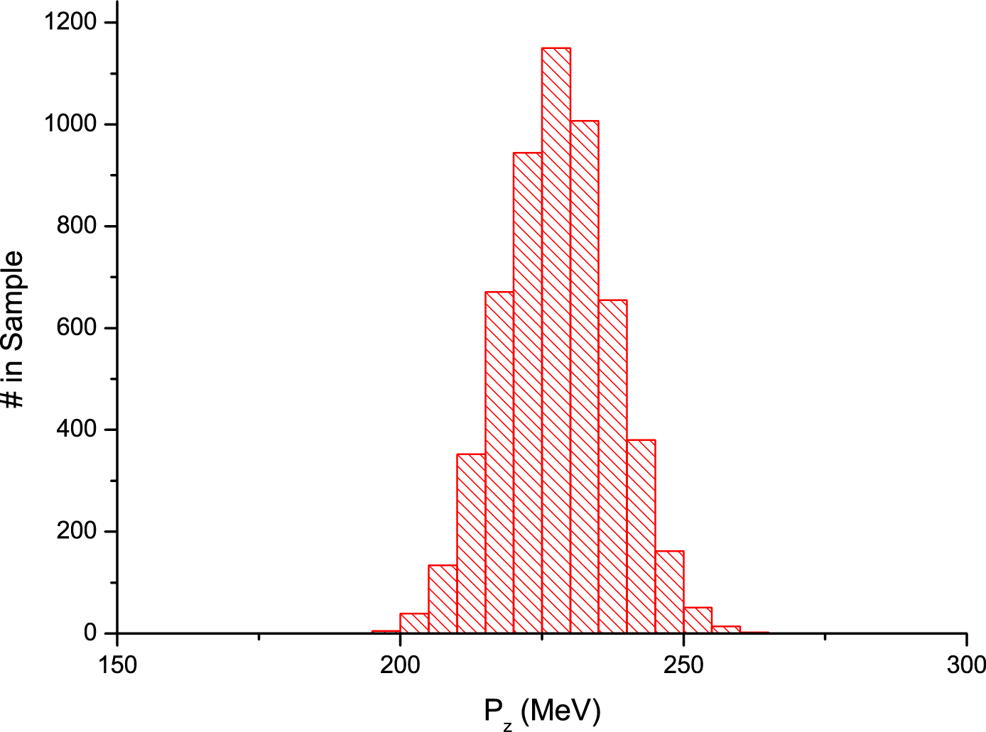
Expected Performance of the Cooling Channel
19/20
$∎$ Propagate measured beams forward through full cooling channel simulation
$∎$Select a ‘NF-like’ Gaussian $p_{z}$ distribution of muons to send down the channel.
Very long tails
Very long tails

Slide 20
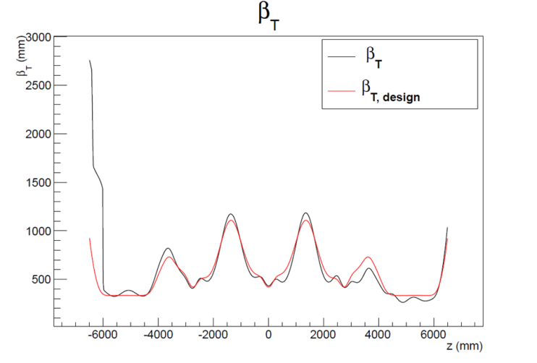
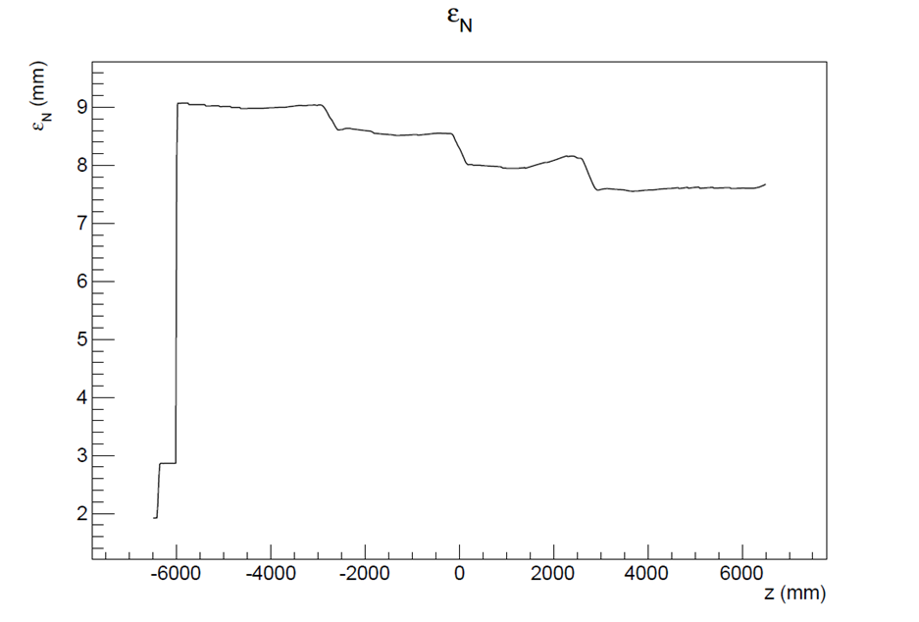
Expected Performance of the Cooling Channel
19/20
$∎$ Propagate measured beams forward through full simulated cooling channel.
$∎$Select a ‘NF-like’ Gaussian $p_{z}$ distribution of muons to send down the channel.
$∎$Track matching through channel.
$∎$Track emittance reduction across the channel.
17%

Slide 21
Conclusions
20/20
First single-particle emittance measurements of the MICE beam line.
Good agreement with simulations.
Propagating a sub-selection of real measured muons through cooling channel demonstrates excellent beam matching and cooling performance.
MICE Step VI promises to be very exciting!

