Slide 1
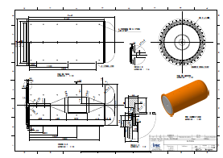
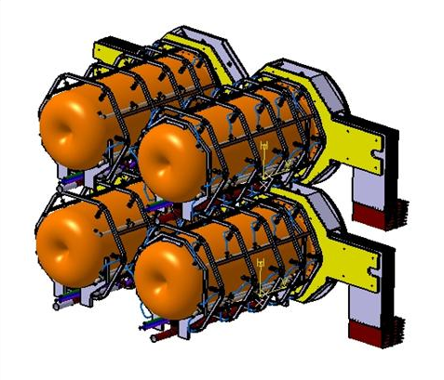
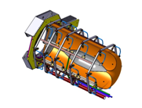
Horn studies for the CERN to Fréjus neutrino Super Beam
Nikolas Vassilopoulos (on behalf of EUROnu WP2), IPHC/CNRS

Slide 2
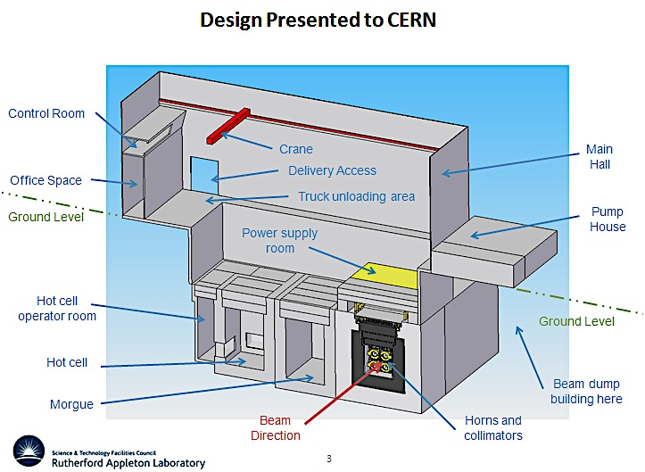
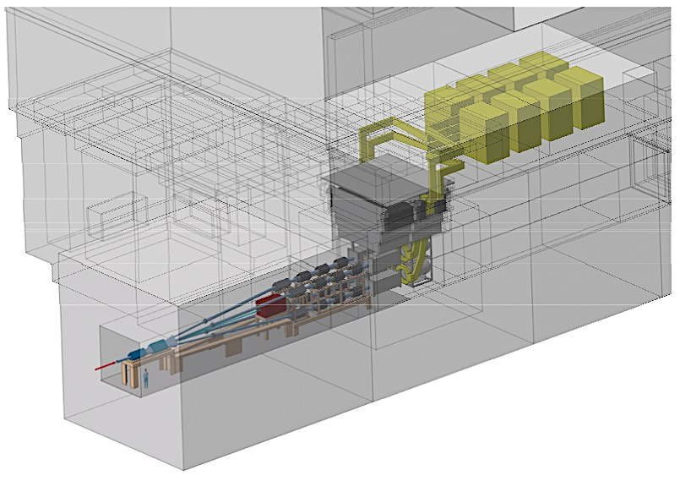
Target station, service galleries
Design includes:
Proton Driver line
Experimental Hall: 4 MW Target Station, Decay Tunnel, Beam Dump
Maintenance Room
Power supply, Cooling system, Air-Ventilation system
Waste Area

Slide 3
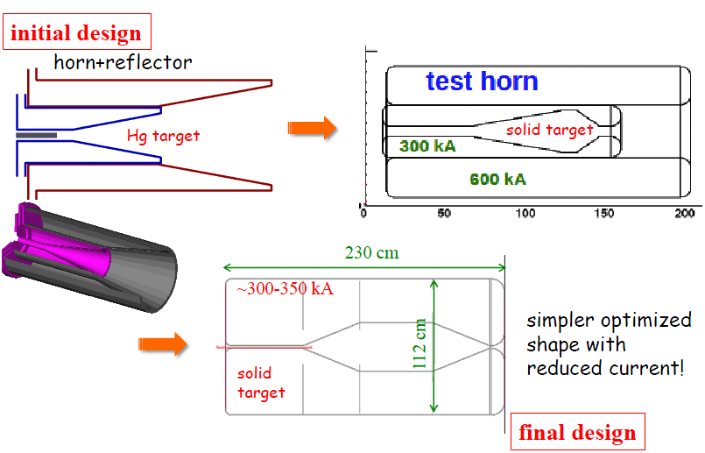
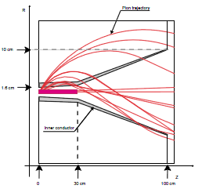
Horn evolution
details in WP2 notes @ http://www.euronu.org/
evolution of the horn shape after many studies:
triangle shape (van der Meer) with target inside the horn : in general best configuration for low energy beam
triangle with target integrated to the inner conductor : very good physics results but high energy deposition and stresses on the conductors
forward-closed shape with target integrated to the inner conductor : best physics results, best rejection of wrong sign mesons but high energy deposition and stresses
forward-closed shape with no-integrated target:
best compromise between physics and reliability
4-horn/target system to accommodate the MW power scale

Slide 4
Horn shape and SuperBeam geometrical Optimization I
studies by A. Longhin, C. Bobeth
parameterise the horn and the other beam elements as decay tunnel dimensions, etc...
parameters allowed to vary independently
minimize the δ_{cp}-averaged 99%CL sensitivity limit on sin²2θ₁₃

Slide 5
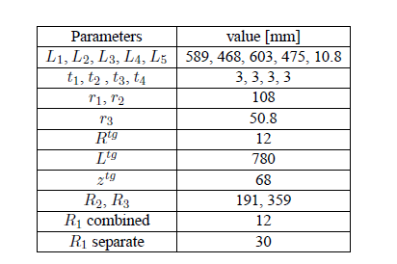
Horn Shape and SuperBeam geometrical Optimization II
fix & restrict parameters then re-iterate for best horn parameters & SuperBeam geometry

Slide 6
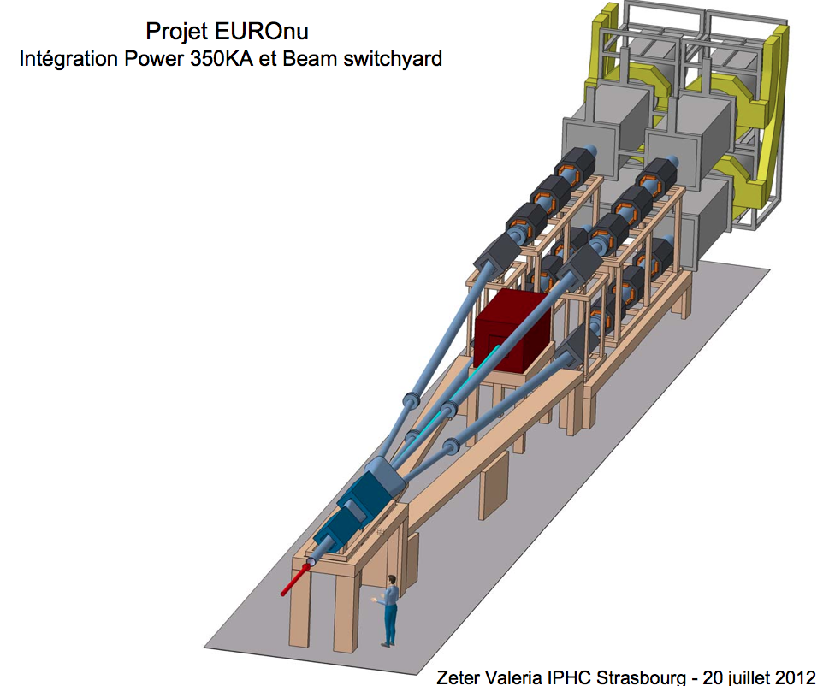
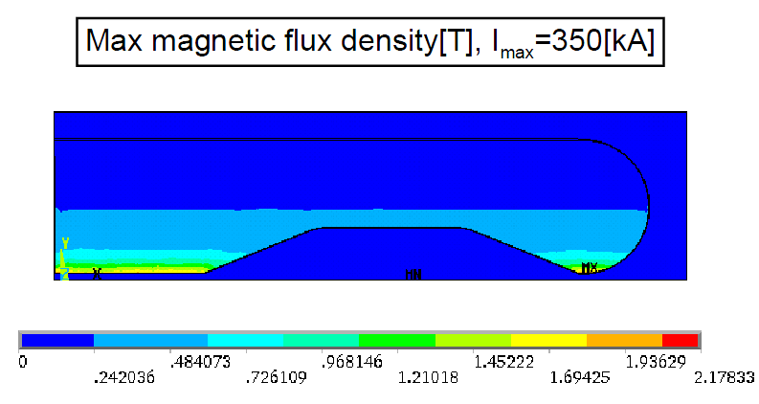
Horn Stress Studies
horn structure
Al 6061 T6 alloy good trade off between mechanical strength, resistance to corrosion, electrical conductivity and cost
horn thickness as small as possible: best physics, limit energy deposition from secondary particles but thick enough to sustain dynamic stress
horn stress and deformation
static mechanical model, thermal dilatation
magnetic pressure pulse, dynamic displacement
COMSOL, ANSYS software
cooling
water jets

Slide 7
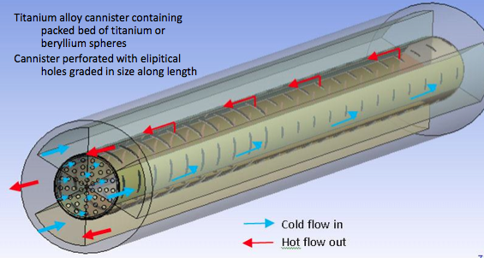
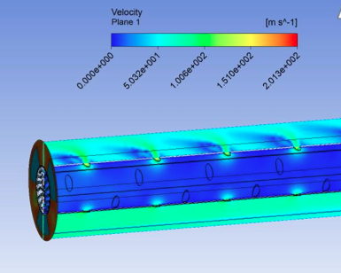
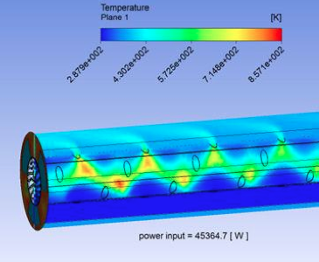
Packed-bed target
He Temperature
He Velocity
transversal cooling
stresses levels manageable

Slide 8
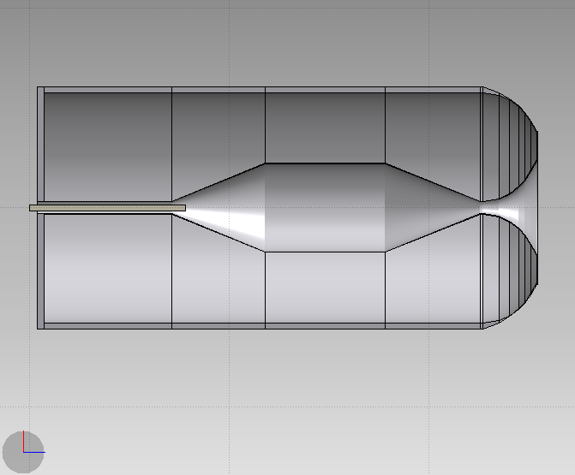
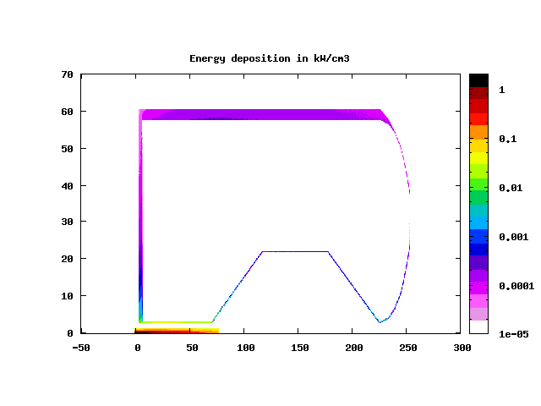
Energy Deposition from secondary particles @1.3 MW
target Ti=65%d_{Ti} , R_{Ti}=1.5cm
36kW, t=30mm
8.6kW, t=35mm
1.7kW
2.4kW
1.3kW
2.5kW
9.5kW
radial profile of power density kW/cm³
P_{tg} = 105kW
P_{h} = 62kW
max

Slide 9
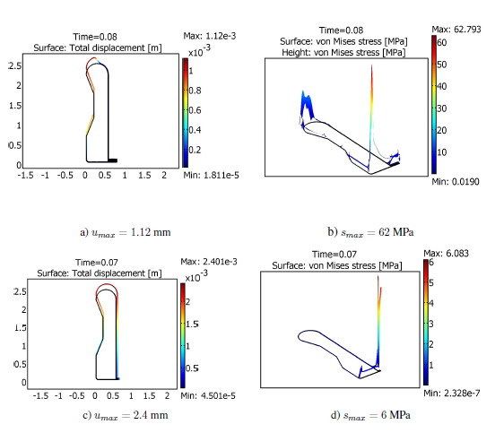
Stress Analysis
Thermo-mechanical stresses:
secondary particles energy deposition and joule losses
T=60ms, (worst scenario, 1horn failed) ,τ_{0I}=100μs, electrical model: I₀ = 350kA, f=5kHz, I_{rms}=10.1kA
u_{max} = 1.12 mm
S_{max} = 63 MPa
cooling T_{Al-max} =60 ⁰C,
stress minimized when horn has uniform temperature
u_{max} = 2.4 mm
S_{max} = 6 MPa
G. Gaudiot, B. Lepers,
F. Osswald, V. Zeter/IPHC,
P. Cupial , M. Kozien, L. Lacny,
B. Skoczen et al. /Cracow Univ. of Tech.
cooling T_{Al-uniform} =60 ⁰C

Slide 10
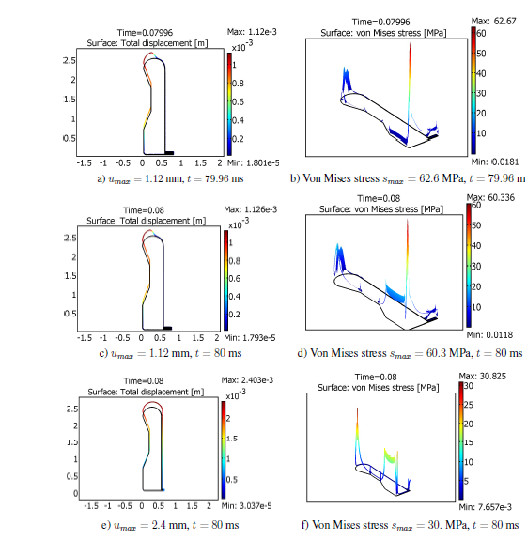
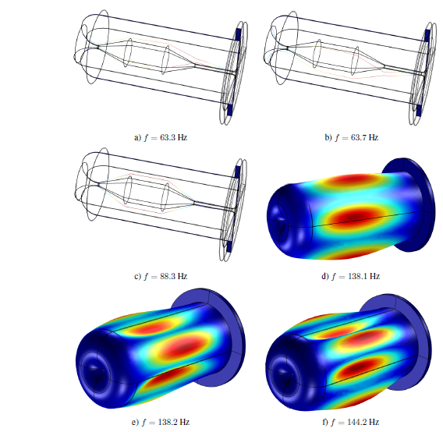
Stress due to thermal dilatation and magnetic pressure
displacements and stress plots just
before and on the peak
stress on the corner and convex region
stress on the upstream inner due to pulse
uniform temperature minimizes stress
t= 79.6 ms
modal analysis, eigenfrequencies
f = {63.3, 63.7, 88.3, 138.1, 138.2, 144.2} Hz
S_{max} = 60 MPa
u_{max} = 1.12 mm
t= 80 ms
1) cooling T_{Al-max} = 60 ⁰C,
inner
S_{max} = 30 MPa
outer
u_{max} = 2.4 mm
t= 80 ms
2) cooling T_{Al-uniform} = 60 ⁰C
peak magnetic field each T=80ms (4-horns operation)

Slide 11
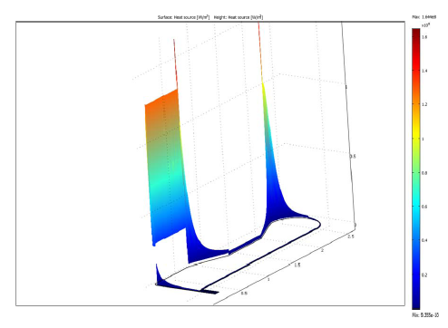
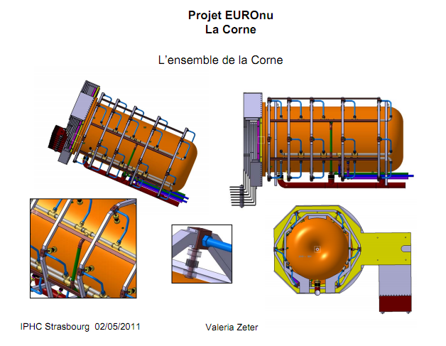
Horn cooling
power distribution on Al conductor
secondary particles (66%) + joule (34 %)
cooling system
planar and/or elliptical water jets
30 jets/horn, 5 systems of 6-jets longitudinally distributed every 60⁰
flow rate between 60-120l/min, h cooling coefficient 1-7 kW/(m²K)
longitudinal repartition of the jets follows the energy density deposition
{h_{corner} , h_{horn}, h_{inner} , h_{convex}}= {3.8, 1, 6.5, 0.1} kW/(m²K) for T_{Al-max} = 60 ⁰C

Slide 12
horn lifetime
6 – 60 MPa expected
highly conservative
1.25 10⁸ pulses = 200 days = 1 year

Slide 13
Power Supply
P. Poussot, J. Wurtz/IPHC

Slide 14
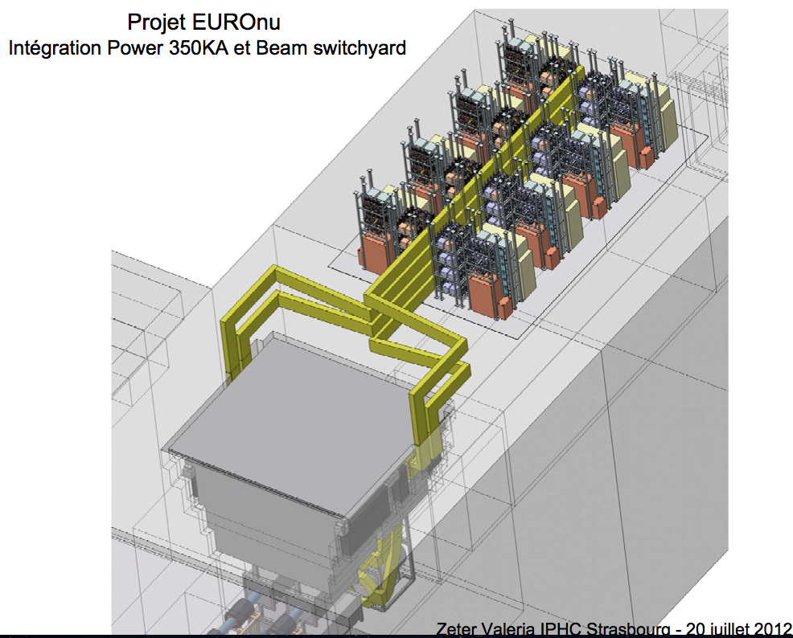

Slide 15
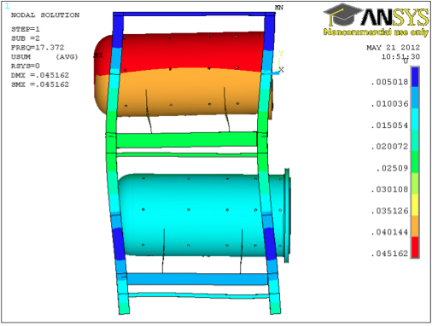
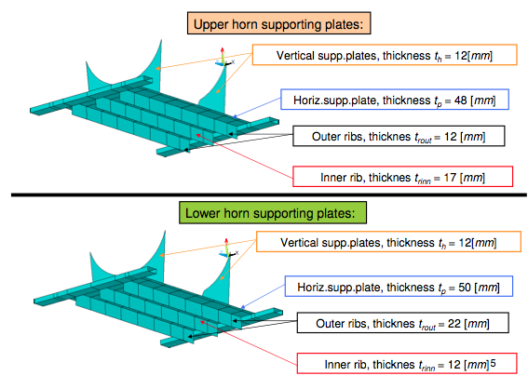
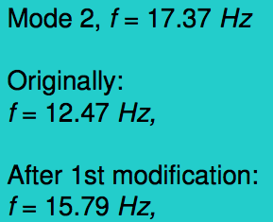
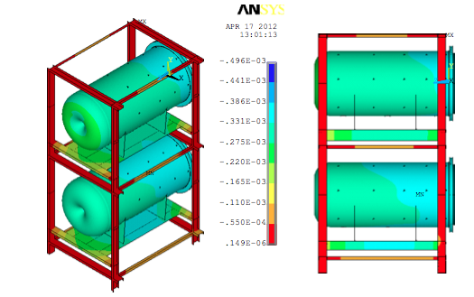
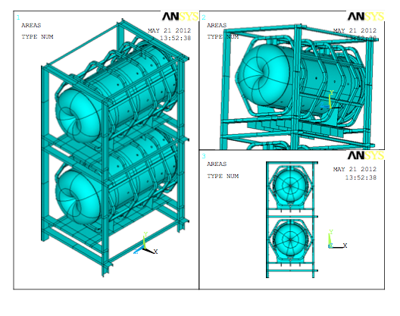
Four-horn support
displacement (m)
foreseen design

Slide 16
conclusions
Al 6061 T6 alloy for radiation, reliability and cost
convex shape defined for optimum physics
low stress on inner conductor when uniform cooling is applied < 30 MPa
horn lifetime > 10⁸ cycles (1 year)
highly conservative
support designed
power supply & cooling R&D needed

Slide 17
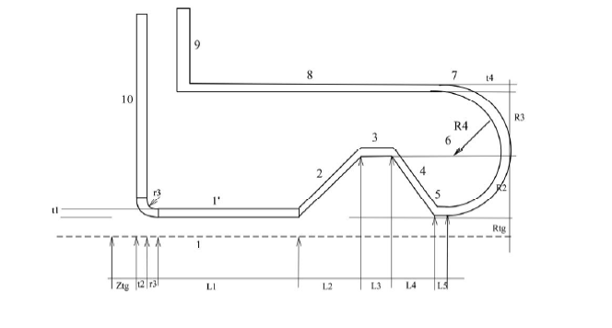
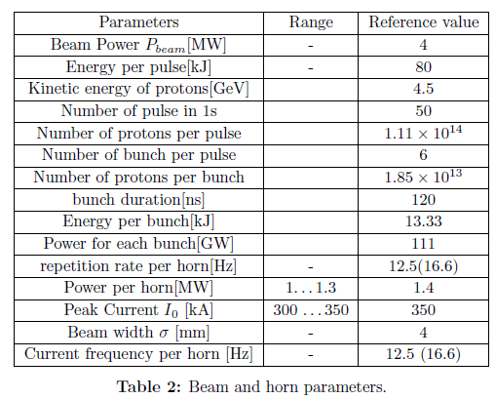
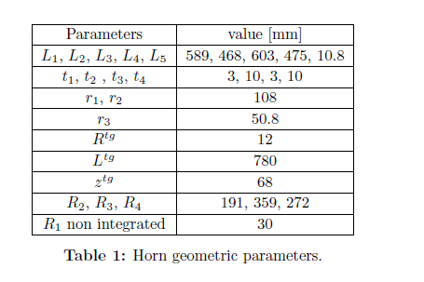
4-horn system for power accommodation

