Slide 1
Mu2e Extinction Systems
Peter Kasper
NuFACT 2012

Slide 2
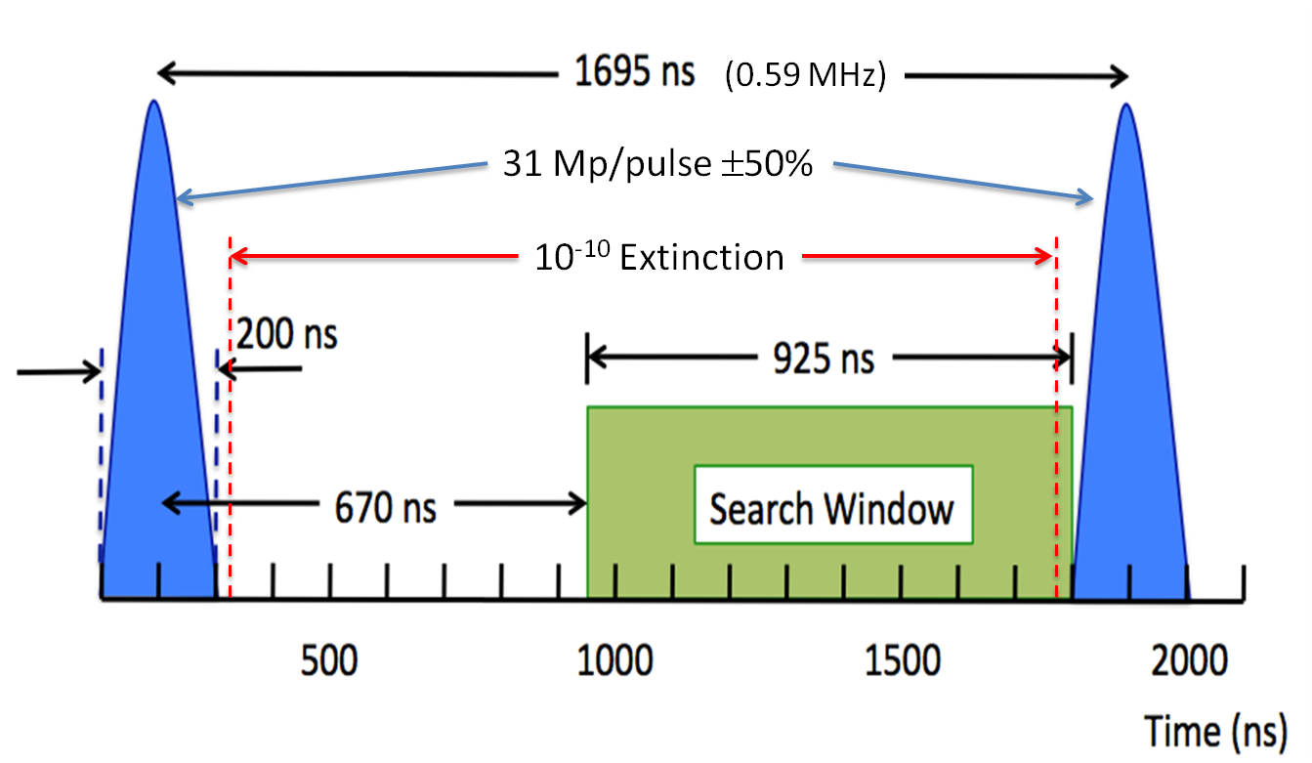
Extinction
Ratio of “out-of-time” to “in-time” beam

Slide 3
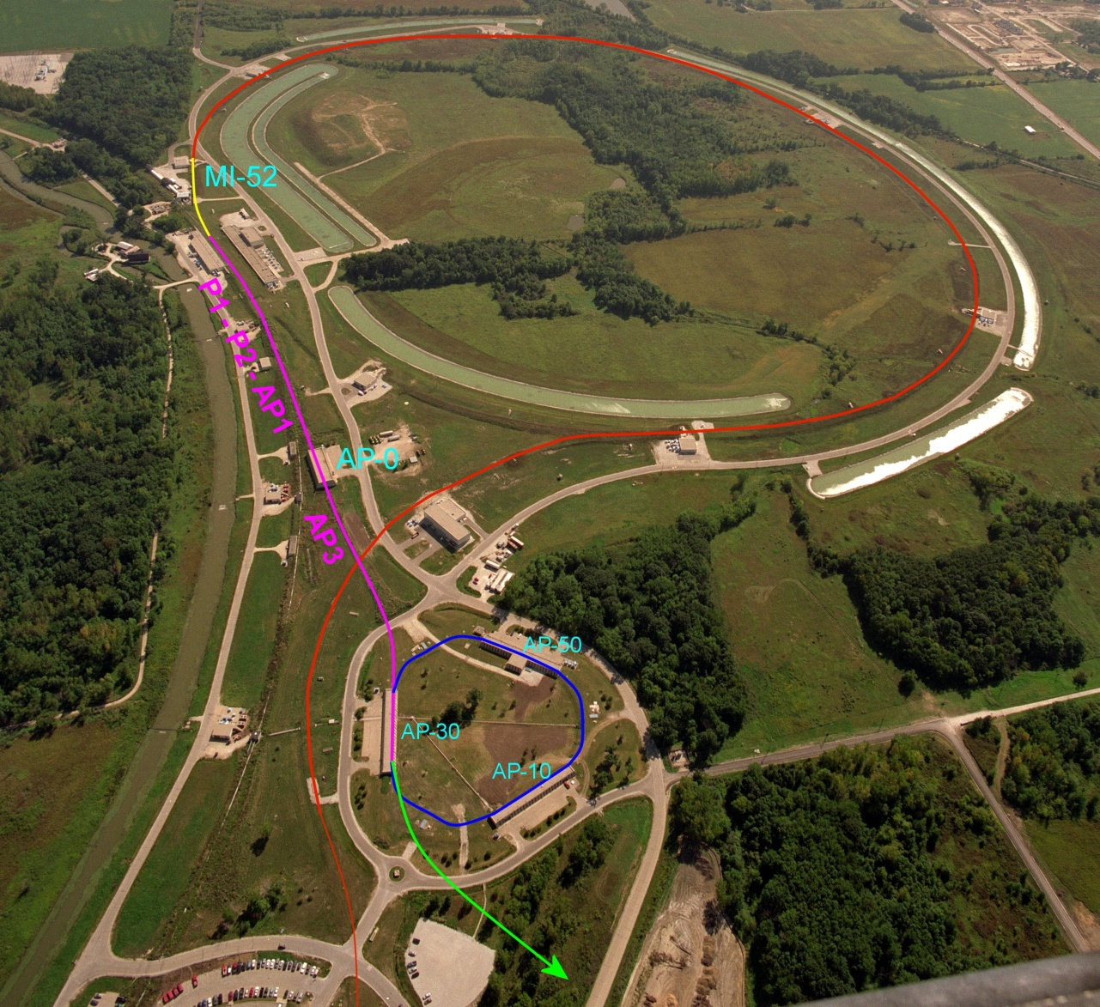
Overview: Proton Delivery
One Booster batch (4x10¹² protons) is injected into the Recycler.
It is divided into 4 bunches.
These are extracted one at a time to the Delivery Ring
  Period = 1.7 μsec
As a bunch circulates, it is resonantly extracted to produce the desired beam structure.
Main Injector/Recycler
Delivery Ring
(formerly pBar Debuncher)
Mu2e
Booster

Slide 4
Extinction Systems
In ring
  Beam delivery technique automatically gives good extinction < 10⁻⁵ going into the Delivery Ring
  May degrade to 10⁻⁴ during the spill
In beam line
  System of dipoles and collimators
  Additional factor of 10⁻⁷ should be possible
Monitoring
  Need to show that 10⁻¹⁰ has been achieved

Slide 5
Delivery Ring
Start with < 10⁻⁵ level of extinction going into the Delivery Ring, so the issue is how will it grow during the spill.
Effects considered
  RF noise
  Intrabeam scattering
  Beam loading
  Beam-gas interaction
  Scattering off of extraction septum ^{Dominant}

Slide 6
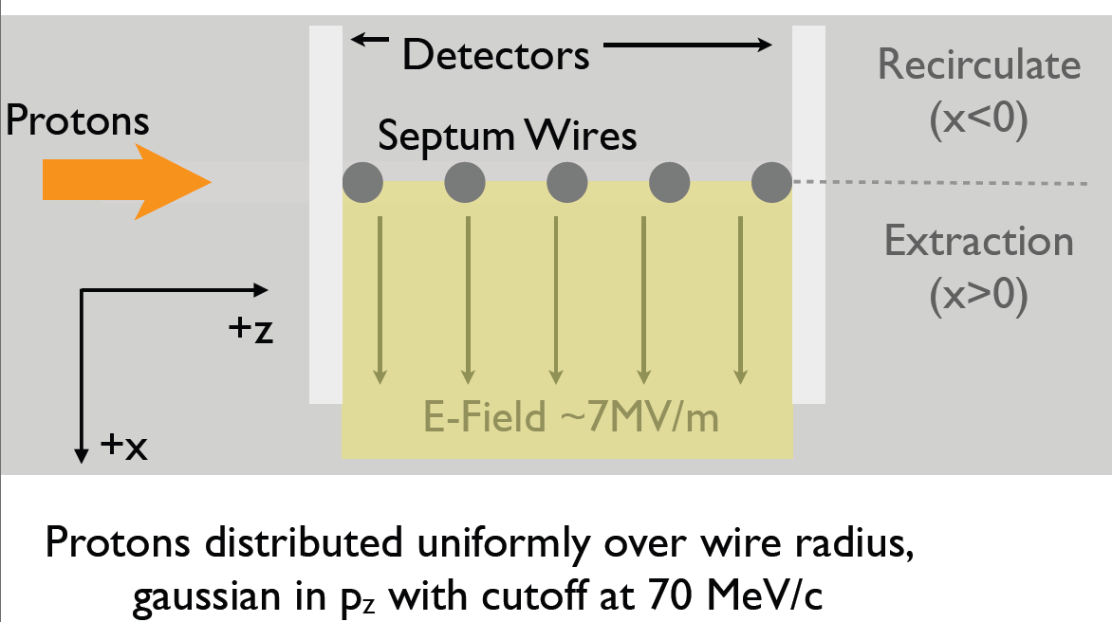
Septum Simulation
Study how the septum affects beam in the delivery ring

Slide 7
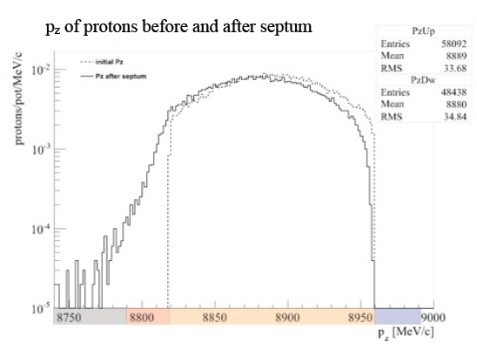
Septum Simulation
Preliminary estimate: Extinction of < 10⁻⁴
Before septum
After septum
Out of Mu2e bucket will not recirculate
In Mu2e bucket and can migrate out-of-time
In Mu2e bucket and will remain in-time

Slide 8
Extinction Beam Line
Delivery Ring
Mu2e Experiment
Extinction Beam Line

Slide 9
Beam Line Modules
Upstream of extinction dipole
  Collimation to define beam line admittance to 50 π-mm-mr
AC dipole region
  Bend plane: β=250m
  Non-bend plane: waist
Extinction collimation
  Minimize transmission of scraping particles
Post-extinction
  High dispersion region for momentum collimation.

Slide 10
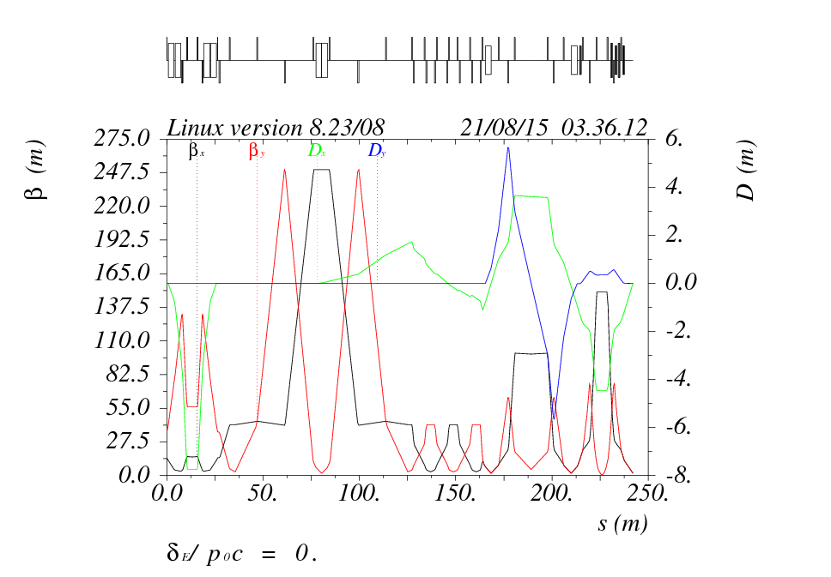
Extinction Beam Line Optics
Momentum collimation
AC Dipole section
Collimation section
Momentum collimation and targeting optics

Slide 11
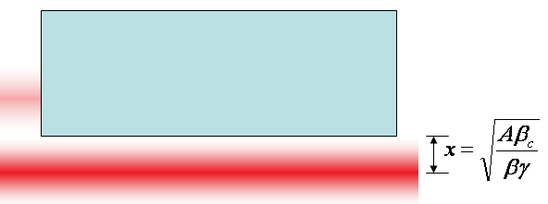
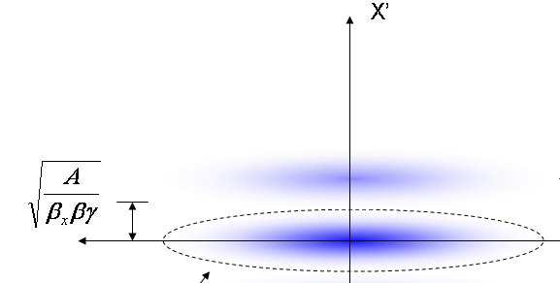
Generic Extinction Analysis
At collimator:
Assume beam occupies entire admittance
Assume pulsed kicker that deflects out-of-time beam into a collimation system
Assume that the beam line admittance is equal to the collimation channel’s admittance
Beam fully extinguished when deflection equals twice full admittance (A) amplitude
At kicker:
Angle to extinguish beam

Slide 12
Magnet Considerations
Complexity scales with stored energy
Bend strength to extinguish:
Stored Energy:
⇒Large β_{x}, long weak magnets
- Assume β_{x}=250m, L=6m
- Factor of 4 better than β_{x}=50m, L=2m

Slide 13
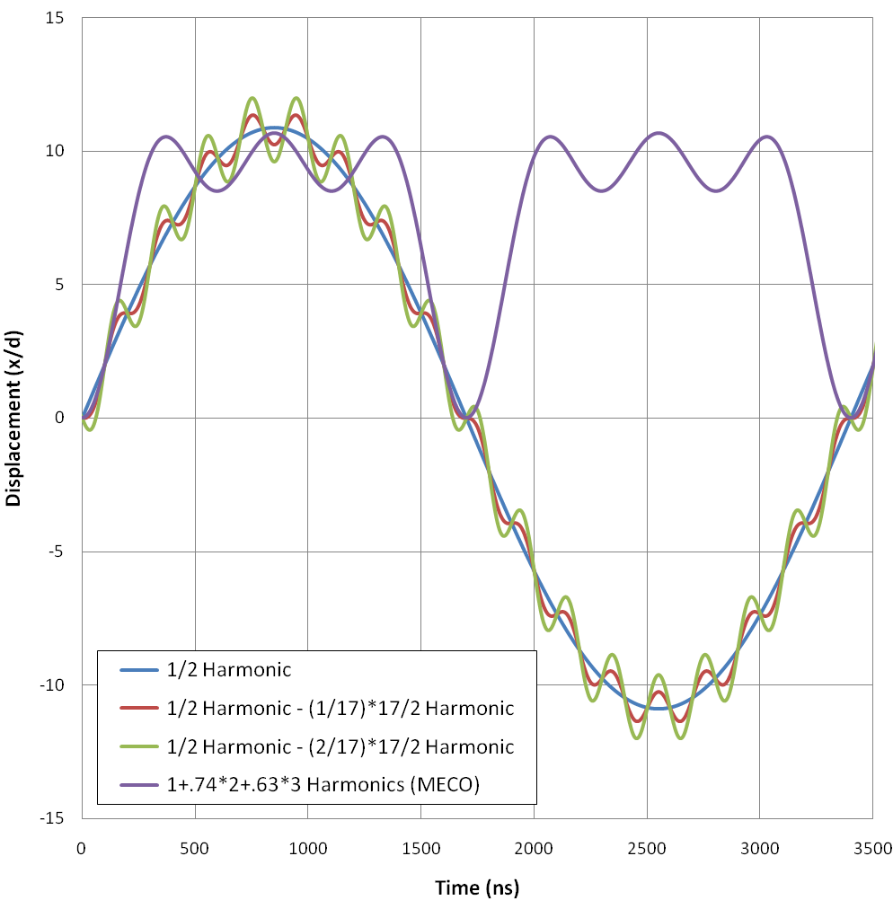
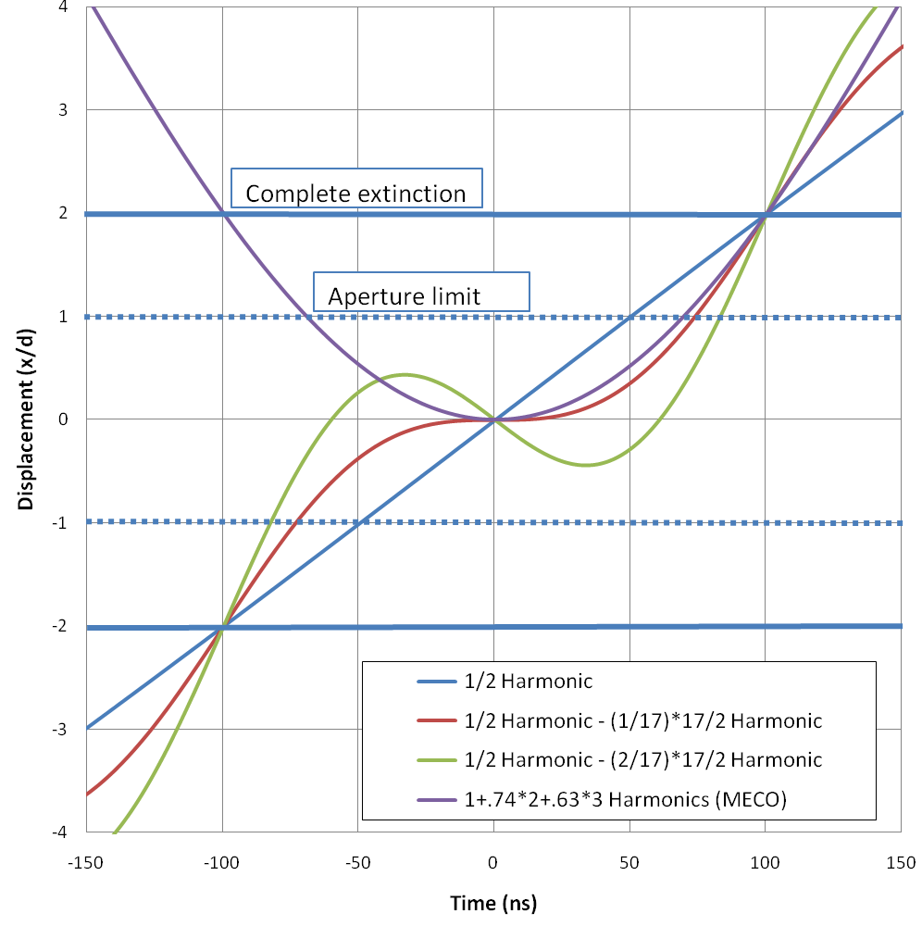
AC Dipole Wave Form
Of the options considered:
½ harmonic – (2/17) * 17/2 harmonic seems most promising
Bunch length
Transmission window

Slide 14
Proton flux vs time of flight
Collimator Material:
Extinction Region
Extinction < 5x10⁻⁸ over range of interest for optimized collimators
This is multiplied by the Delivery Ring factor to produce a total extinction of < 5x10⁻¹²
Time (ns)

Slide 15
Monitor Requirements
Demonstrate 10⁻¹⁰ extinction
  Assume ≈ 3 x 10⁷ protons/bunch
  Not possible measure 10⁻¹⁰ with a single bunch
    ⇒ Integrate over many bunches
  Integration time should be < ≈ 1 hour
Only protons hitting the target can cause backgrounds
  Monitoring beam itself will lead to a potentially large over estimate of the background to the experiment
  ⇒ Monitor target interaction products

Slide 16
Filter + Detector Strategy
Filter
  Selects a sample of suitable secondaries and delivers them to the detector
  Sets the per proton detector signal rate
  Shields the detector from unwanted interaction products
Detector
  Measure “in-time” and “out-of-time” signal rates with equal or known relative efficiency
  Must have LOW “out-of-time” backgrounds compared to signal rate

Slide 17
Two Schemes Under Consideration
Pixel Tracker
  Located above and behind the proton absorber
  Samples 3 to 4 GeV/c positive charged secondaries
  Pixel detectors reconstruct and count straight tracks with a well defined direction in 25ns time bins
Mini Spectrometer
  Located beside the proton absorber
  Samples ~ 1 GeV/c positive charged secondaries
  Magnetic spectrometer with 4 scintillator stations measures dE/dx, time of flight, and momentum of identified particle tracks

Slide 18
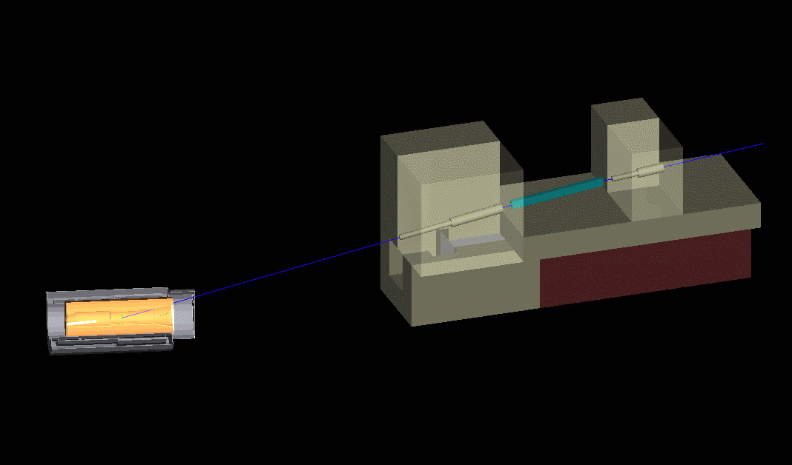
Filter for Pixel Monitor
Filter magnet
Monitor
(too small to see)
Production solenoid
Target
(too small to see)
Proton Beam
Primary beam absorber
Entry and exit collimators
20 m

Slide 19
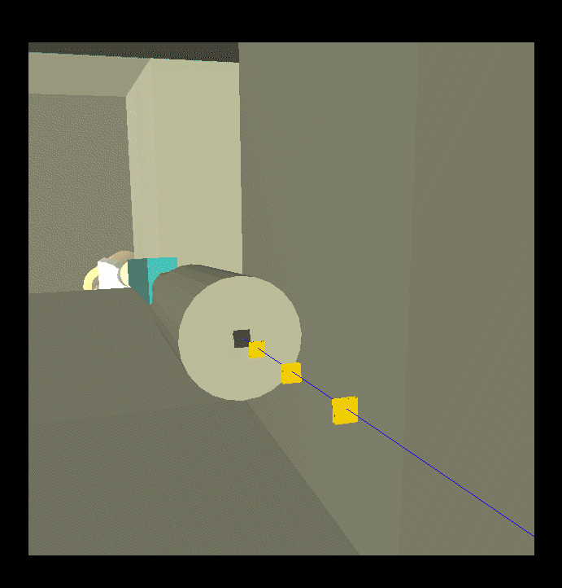
Pixel Detector
Exit collimator opening
3 x 2 stations of Atlas style pixel detectors.
Each station is comprised of 4 2 x 2 cm FE-14 sensor chips with 26,880
250 x 50 μm pixels per chip

Slide 20
Pixel Detector Features
Filter
  Filter magnet is an existing permanent dipole
    No cost and no maintenance
  Locates detector outside target hall
    Easy access for detector maintenance
    Lots of room for shielding
    Low radiation levels for detector + electronics
Detector
  Mature technology
    Can piggy-back on ATLAS purchases
  Simple reconstruction
    Possible to reconstruct every signal track from every bunch in real time?

Slide 21
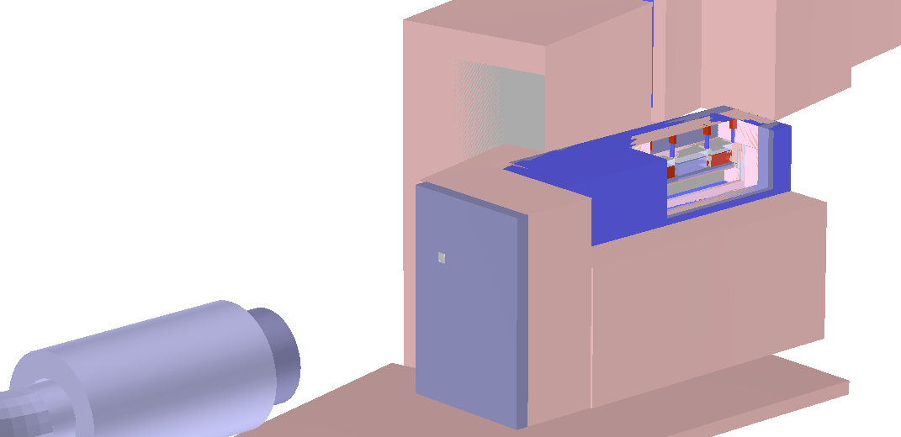
Mini Spectrometer Option
Spectrometer
Primary beam absorber
Entry collimator
Production solenoid
Iron shielding
Concrete shielding

Slide 22
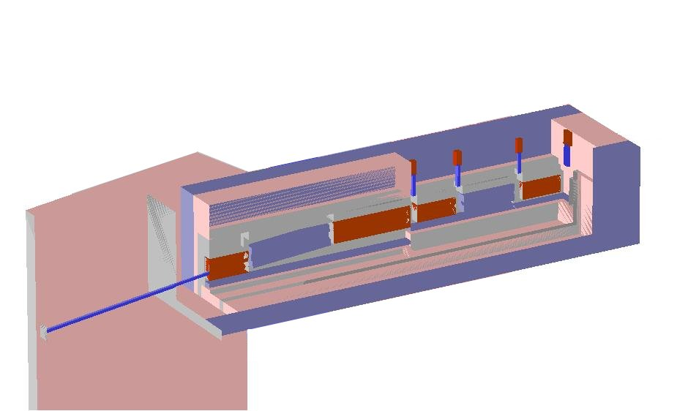
Mini Spectrometer Option
Spectrometer magnet
8 scintillator strips per detector station read out by MPPC’s with 0.05 ns time resolution
Front detector stations
Rear detector stations
Filter magnet
Entry collimator
Iron lined with zirconium hydrate poly shielding
Brass collimators

Slide 23
Mini Spectrometer Features
Located inside target hall
  Reduces civil construction costs
Filter and spectrometer magnets obtained by cutting up an existing permanent dipole
Detector provides more measurables
  dE/dx + time of flight distinguishes π‘s and p’s
  Momentum measurement rejects low momentum background

Slide 24
Choice
Based on how well each design meets a comprehensive list of requirements
Studies well advanced but have yet to be completed and documented

Slide 25
Requirements: Signal Rate
Determined from beam intensity
  3 x 10⁷ protons/bunch
  Bunch rate: 0.6 MHz @ 33% duty factor
  ⇒ 2 x 10¹⁶ in-time p.o.t./hr
  10⁻¹⁰ extinction ⇒ 2 x 10⁶ out-of-time p.o.t./hr
To set a 90% C.L.
  Need 2.3 expected out-of-time signal/hr
  ⇒ 1.2 x 10⁻⁶ signal events per p.o.t.
Pixels: 1.6 x 10⁻⁶ (limited by detector area)
Spectrometer: 1.0 x 10⁻⁶ (pile-up effects)

Slide 26
Requirements: Background
Out-of-time background << a few events/hr
Background sources
  Cosmic rays
    Pixels: 0.03 evts/hr Spectrometer: negligible
  Late hits from in-time interactions
    Flux is 1,000 times higher for Spectrometer but it can more easily reject them
    Pixels can reject low momentum with a track quality and angle cuts
  Induced radioactivity
    Initial calculations suggest that it is negligible
  Electronic noise
    Pixels: negligible
    Spectrometer: radiation damage may be an issue

Slide 27
Requirements: Reliability
Sensitivity to protons missing the target
  Out-of-time beam is flat over defining aperture
    Possibly only about 1% will hit the target
    Rest don’t make experiment backgrounds
  Both options insensitive if beam does not scrape on the Production Solenoid’s heat and radiation shield
In-time measurement linearity w.r.t. p.o.t./bunch must be well understood
  Noise rates, Pile-up, Reconstruction errors and efficiency
  Pixels expected to be linear
  Spectrometer preliminary reconstruction has ~15% inefficiency and finds ~15% fake tracks

Slide 28
Requirements: Practicality
Sensitivity to design parameters
  Alignment tolerances
  Production solenoid field strength
  Pixel filter more vulnerable since collimators are embedded in bulk concrete but designed to accommodate placement errors of ~3 inches
Diagnostics
  Real time (low sensitivity) measurement
  Background monitoring
  Averaged bunch structure measurements
  Sanity checks
  Spectrometer provides more information and has better time resolution but will have to pre-scale in-time bunches
Feasible : cost, construction, operating and maintenance
  Pixels: Detector is cheaper, simpler, and easier to maintain
  Spectrometer: Cheaper civil construction

Slide 29
Summary
Looks feasible
Need better understanding of out-of-time beam distribution at the production solenoid
Will choose between monitor options in the couple of months

