Slide 1
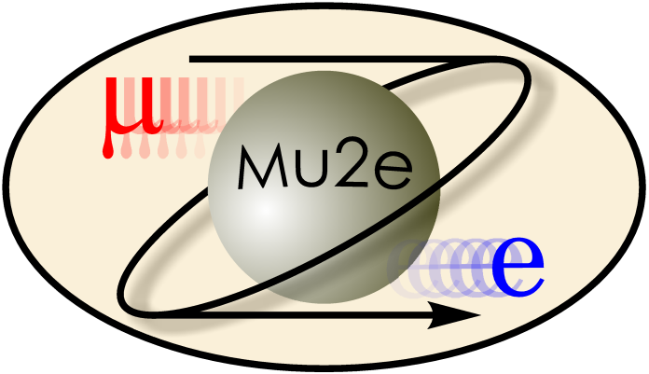
Radiation Damage to Mu2e Apparatus
V. Pronskikh
Fermilab
NuFact’12, July 23-28, 2012, Williamsburg

Slide 2
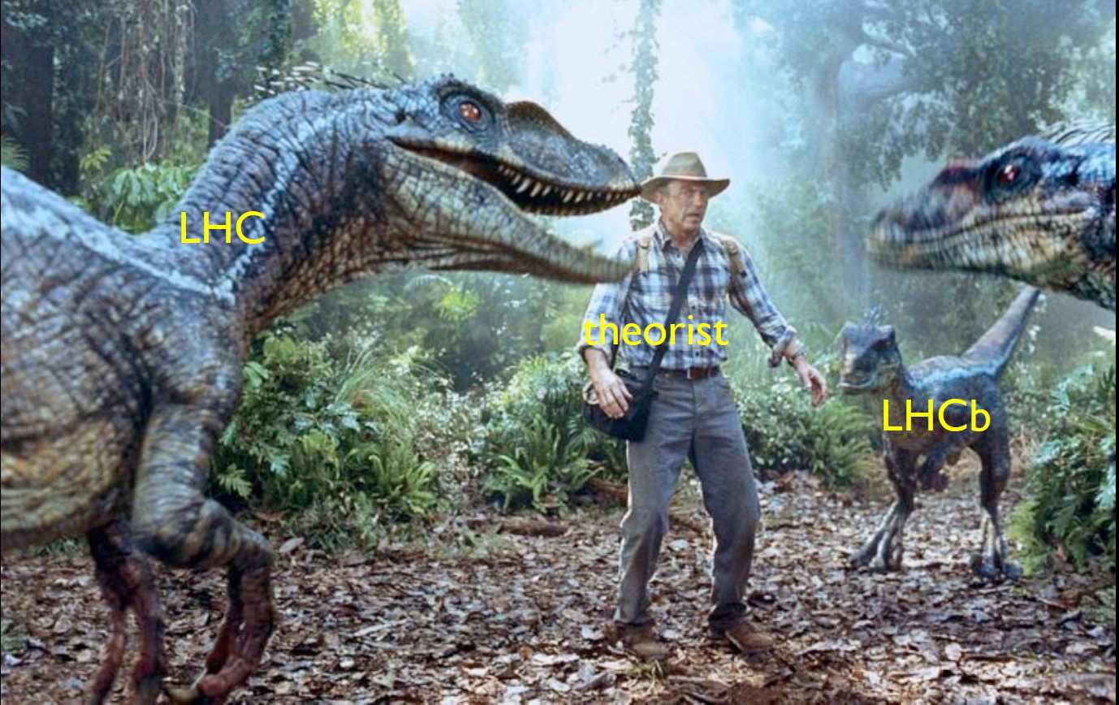
Issues for high-intensity experiments
Radiation Damage
Contingency
Target Designer
Remote
Handling
After R.Tschirhart and H. Murayama
V. Pronskikh, Radiation damage, NuFact’12, July 23-28, Williamsburg

Slide 3
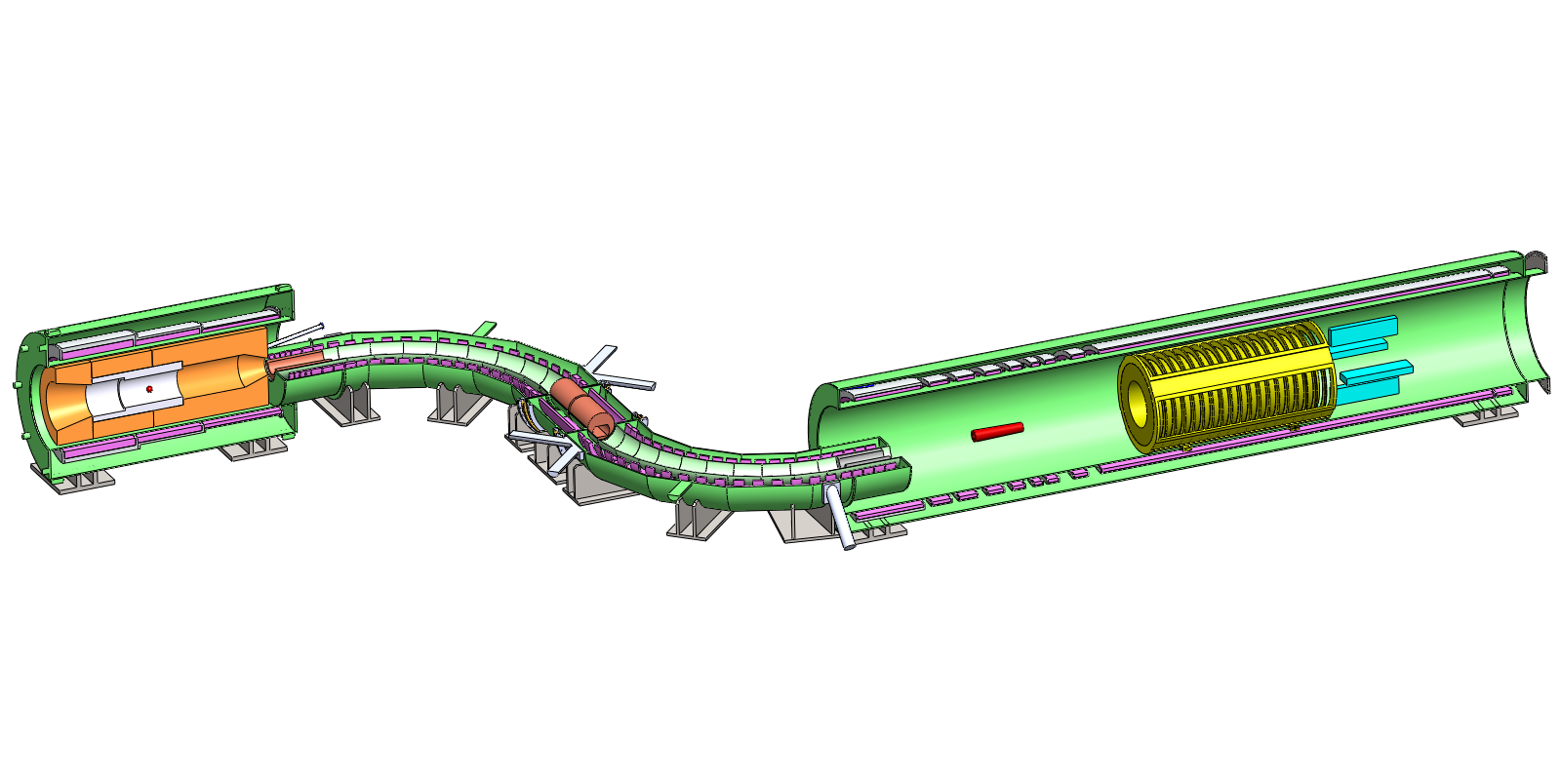
Mu2e apparatus
Production
Solenoid
Detector
Solenoid
Transport
Solenoid
protons
1.0T
e⁻
μ⁻, π⁻
2.5T
~5T
Production
Target
2.0T
Stopping
Target
Calorimeter
Collimators
Tracker
(not shown: Cosmic Ray Veto, Proton Dump, Muon Dump, Proton/Neutron absorbers,
Extinction Monitor, Stopping Monitor)
V. Pronskikh, Radiation damage, NuFact’12, July 23-28, Williamsburg

Slide 4
Object and Issues
Object:
Primarily, production solenoid of Mu2e with 8-GeV proton beam, also applicable to COMET, Muon Collider, Project X, Neutrino Factory and other superconducting setups in high radiation fields
Main goal:
Maximize useful particle production, minimize background particle yields
Issues:
Quench: power density and dynamic heat load of superconducting (SC) coils.
Integrity and lifetime of critical components: integrated dose in organic materials, i.e. epoxy, insulator.
Radiation damage to superconducting and stabilizing materials: atomic displacements (DPA), integrated particle flux
Damage to electronics (single event upsets (SEU), lifetime)
Safety aspects: shielding, nuclide production, residual dose, etc.
V. Pronskikh, Radiation damage, NuFact’12, July 23-28, Williamsburg

Slide 5
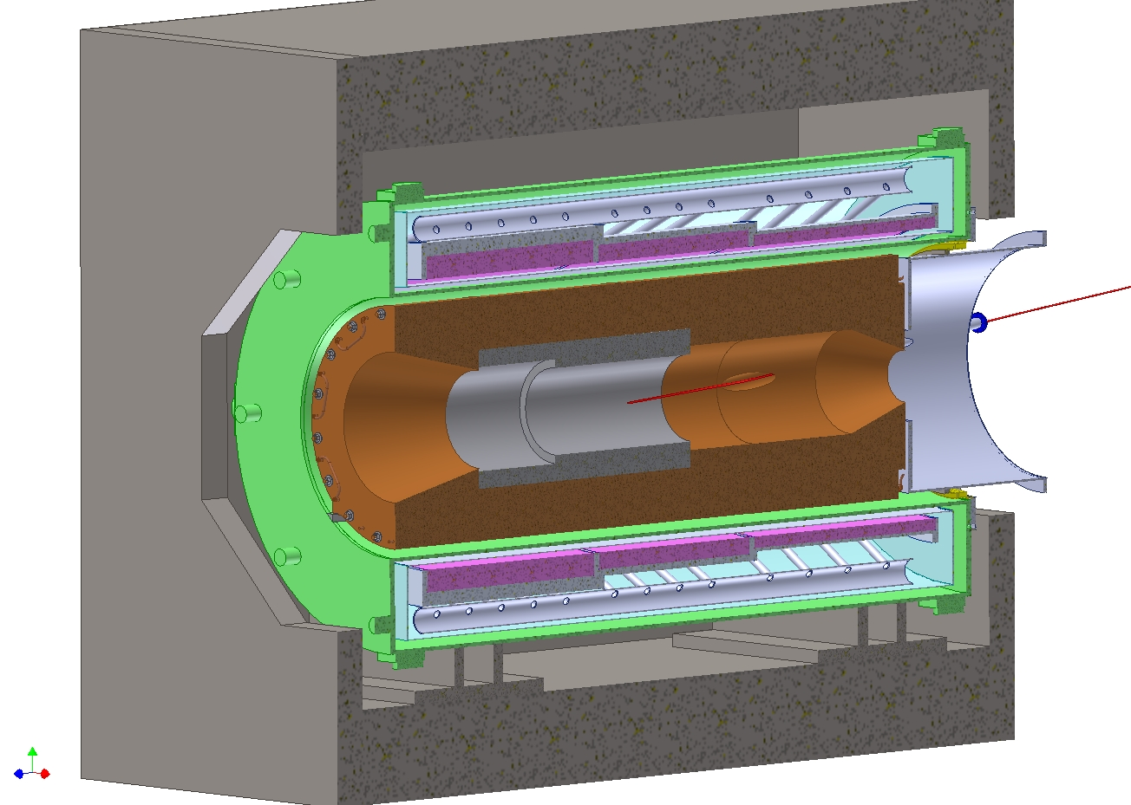
Requirements to Mu2e Heat and Radiation Shield
Absorber (heat and radiation
shield) is intended to prevent
radiation damage to the magnet
coil material and ensure quench
protection and acceptable heat
loads for the lifetime of the
experiment
Total dynamic heat load on the coils
Peak power density in the coils
Peak radiation dose to the insulation and epoxy
Displacements Per Atom (DPA) to describe how radiation affects the electrical conductivity of metals in the superconducting cable
V. Pronskikh, Radiation damage, NuFact’12, July 23-28, Williamsburg

Slide 6
Displacement per atom (DPA)
DPA (displacement per atom). Radiation damage in metals, displacement of atoms from their equilibrium positions in a crystalline lattice due to radiation with formation of interstitial atoms and vacancies in the lattice.
A primary knock-on (PKA) atom is formed in elastic particle-nucleus collisions, generates a cascade of atomic displacements.
A PKA displaces neighboring atoms, this results in an atomic displacement cascade. Point defects are formed as well as defect clusters of vacancies and interstitial atoms (time scale=ps).
Residual Resistivity Ratio degradation (RRR, ratio of the electric resistance of a conductor at room temperature to that at the liquid He one), the loss of superconducting properties due to change of conditions of electron transport in metals.
V. Pronskikh, Radiation damage, NuFact’12, July 23-28, Williamsburg

Slide 7
Mu2e Requirements
Quantity | DPA, 10⁻⁵ | Power density, µW/g | Absorbed dose, MGy | Dynamic heat load, W
Specs | 4-6 | 30 | 7 | 100
DPA damage we can get so that RRR degrades from ~1000 to 100. After this RRR reduction we must warm-up and anneal Al (once a year).
Definite cooling requirements lead to limits on peak power density calculated based on the heat map
Dynamic heat load limit depends on cooling system
V. Pronskikh, Radiation damage, NuFact’12, July 23-28, Williamsburg

Slide 8
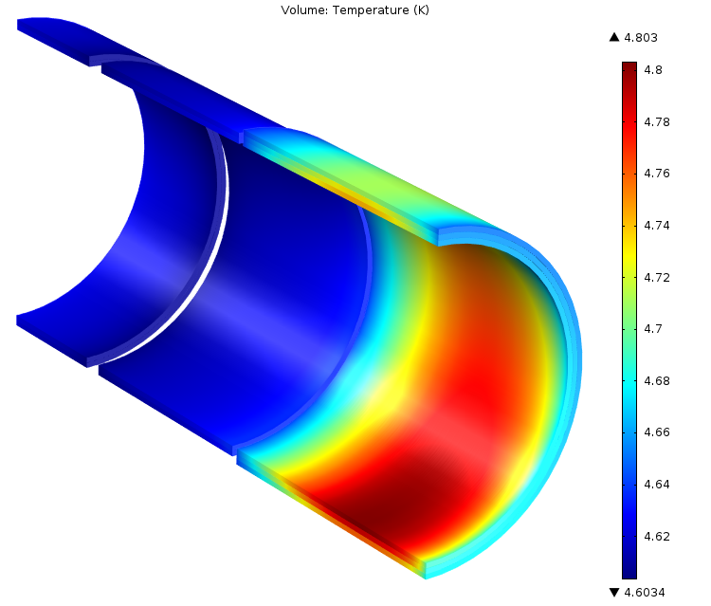
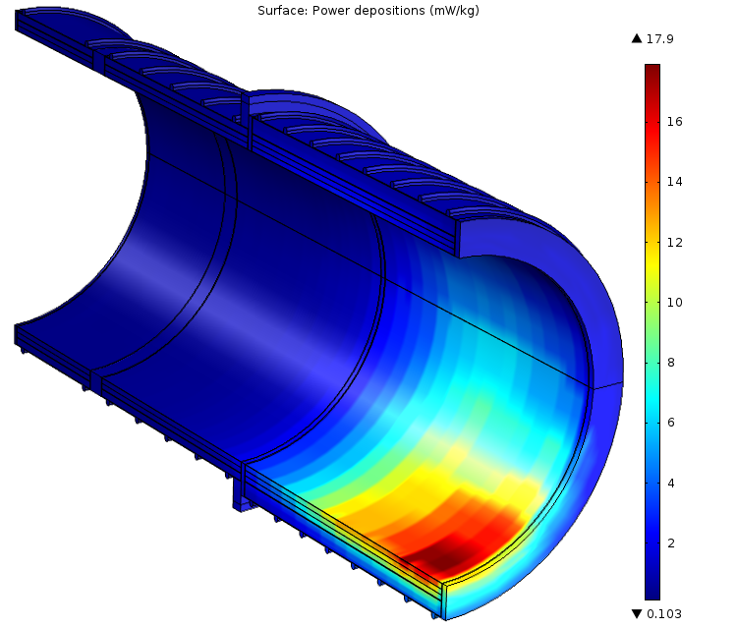
Requirements. Peak power density
Volume temperature, K
Surface power deposition, µW/g
p
4.8 K
17.9 µW/g
p
T plot for T₀ =4.6K (liquid He temp)
T_{c} = 6.5K; (supercond+field)
T_{peak} = T_{c}-1.5K = 5.0K.
Peak coil temperature starts to violate allowable value based on 1.5 K thermal margin and 5 T field after 30 µW/g
MARS15
V. Pronskikh, Radiation damage, NuFact’12, July 23-28, Williamsburg

Slide 9
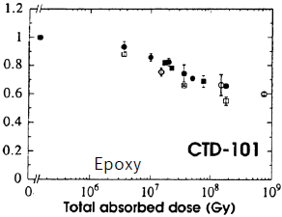
Requirements. Absorbed dose to organic materials
Ultimate tensile strength degradation
7 MGy before 10% degradation
of ultimate tensile strength
(shear modulus).
Mu2e apparatus lifetime is 5 years
Current LHC limit 25-50 MGy over
the lifetime
e-, γ, n
also Radiation Hard Coils, A. Zeller et al, 2003, http://supercon.lbl.gov/WAAM
UTS/UTS0
From M.Eisterer, RESMM12 Workshop, February 2012, Fermilab
V. Pronskikh, Radiation damage, NuFact’12, July 23-28, Williamsburg

Slide 10
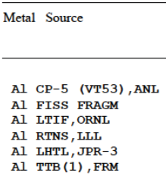
Mu2e Requirements. RRR vs DPA
RRR(DPA) = $\frac{ρ_{hi }^{}}{ρ_{0}+\frac{ ∆ρ_{ }^{}}{DPAρ}∗DPA}$
NRT model of DPA
$∆ρ$ – from KEK measurement
Range 4-6E-5
Broeders, Konobeyev, 2004
$η=\frac{N_{D}}{N_{NRT}}$; 0.357 – 0.535
scales NRT to experiment
V. Pronskikh, Radiation damage, NuFact’12, July 23-28, Williamsburg

Slide 11
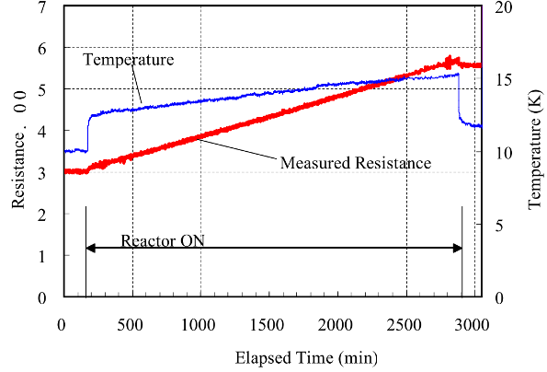
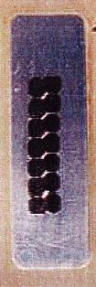
RRR degradation per DPA
Kyoto University Reactor
５MW max. thermal power
Cryostat close to reactor core
Sample cool down to 10K – 20K
CERNOX sensors
Fast neutron flux 1.4x10¹⁵ n/m²/s (>0.1MeV) @1MW
45 hours
M.Yoshida
3.1μΩ ◊ 5.7μΩ
induced ρ_{i} = 0.056 nΩ.m
for 2.3x10²⁰ n/m²
(>0.1MeV)
Mu2e Expected fluence
(>0.1 MeV) ~ 2.5x10²¹ n/m²
Aluminum stabilizer sample
1mmx1mmx70mm
V. Pronskikh, Radiation damage, NuFact’12, July 23-28, Williamsburg

Slide 12
DPA Modeling Status
Codes using NRT model (MARS15, FLUKA, PHITS) agree quite well (10-20%).
Industry standard NRT and state-of-the-art models (BCA-MD) differ by a factor of 2 to 3 in some cases
More experiments at high-energy neutron spectrum are necessary to benchmark models
More data on non-annealable (irreversible, transmuted DPA) are very important for experiments with spallation targets (Mu2e, COMET, Project X etc.)
V. Pronskikh, Radiation damage, NuFact’12, July 23-28, Williamsburg

Slide 13
MARS15 DPA model development
Al
Broeders, Konobeyev, 2004
Based on ENDF/B-VII, calculated for 393 nuclides
NRT (industry standard) corrected for experimental η
η – ratio of number of single interstitial atom vacancy pairs (Frenkel
pairs) produced in a material to the number of defects calculated using
NRT model
V. Pronskikh, Radiation damage, NuFact’12, July 23-28, Williamsburg

Slide 14
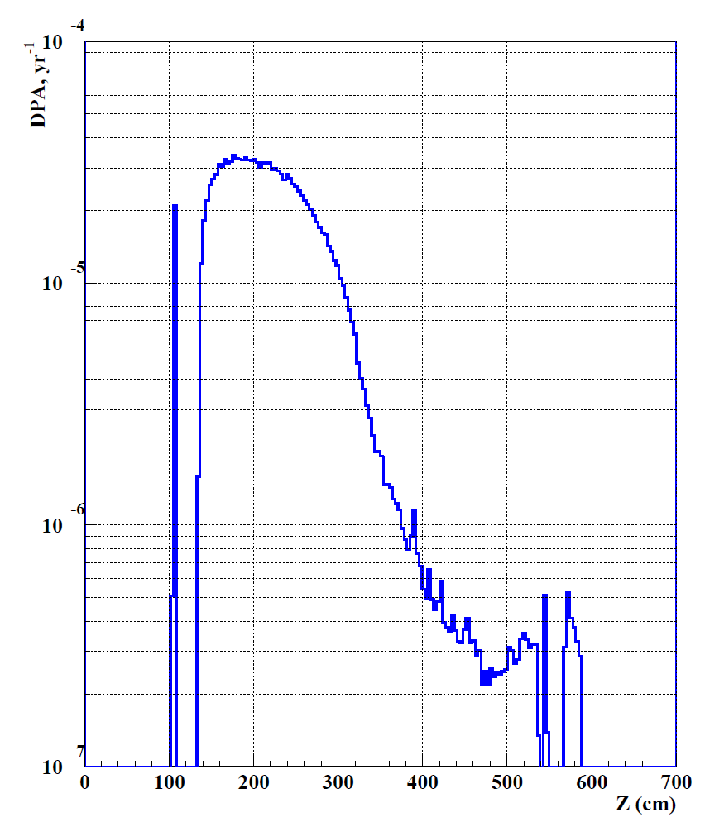
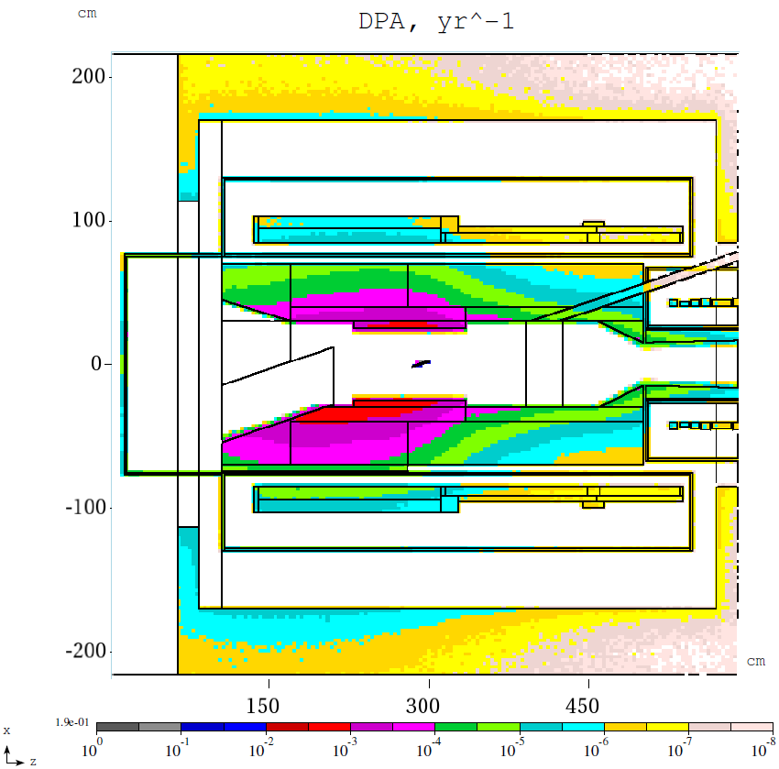
DPA for 8-kW beam power baseline
Limit 4-6*10⁻⁵
3.2*10⁻⁵ yr^-1
V. Pronskikh, Radiation damage, NuFact’12, July 23-28, Williamsburg

Slide 15
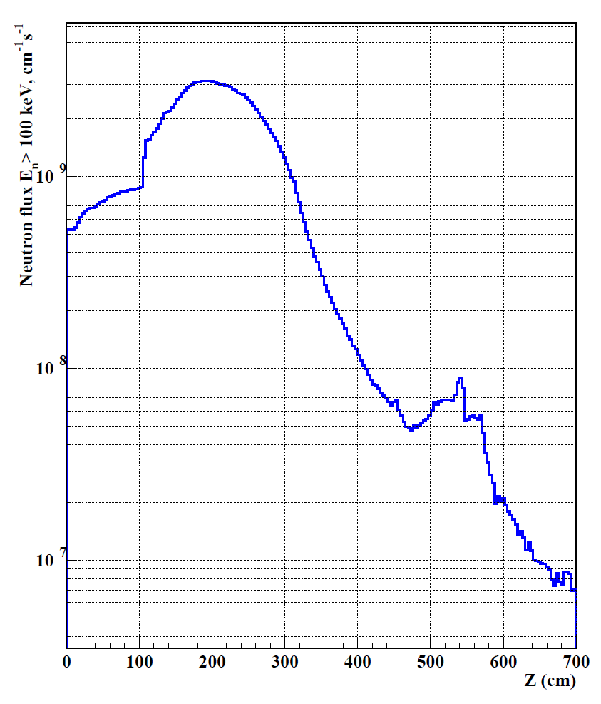
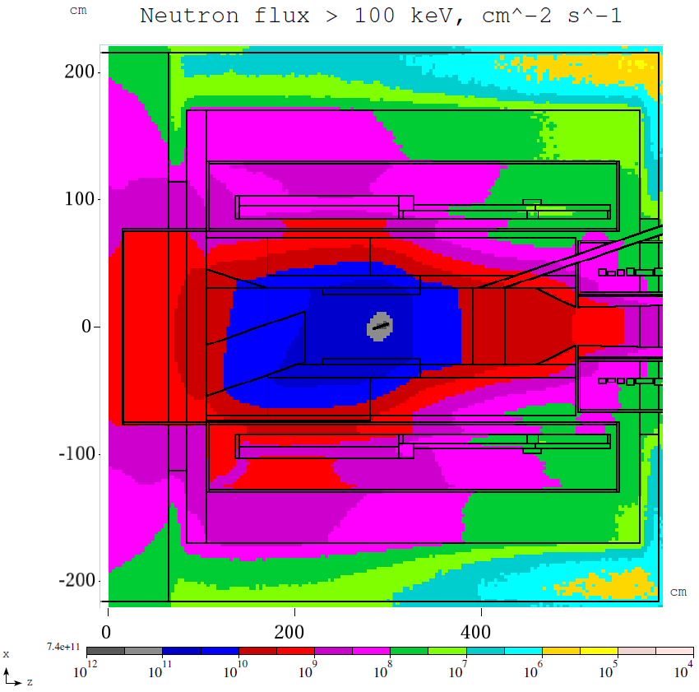
Neutron flux >100 keV
Lifetime ~3.1x10²¹ n/m²
3.1*10⁹ cm^-2s^-1
V. Pronskikh, Radiation damage, NuFact’12, July 23-28, Williamsburg

Slide 16
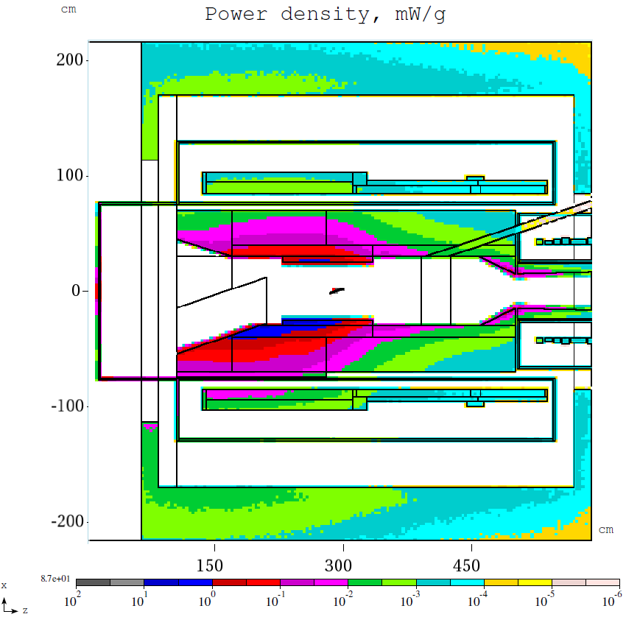
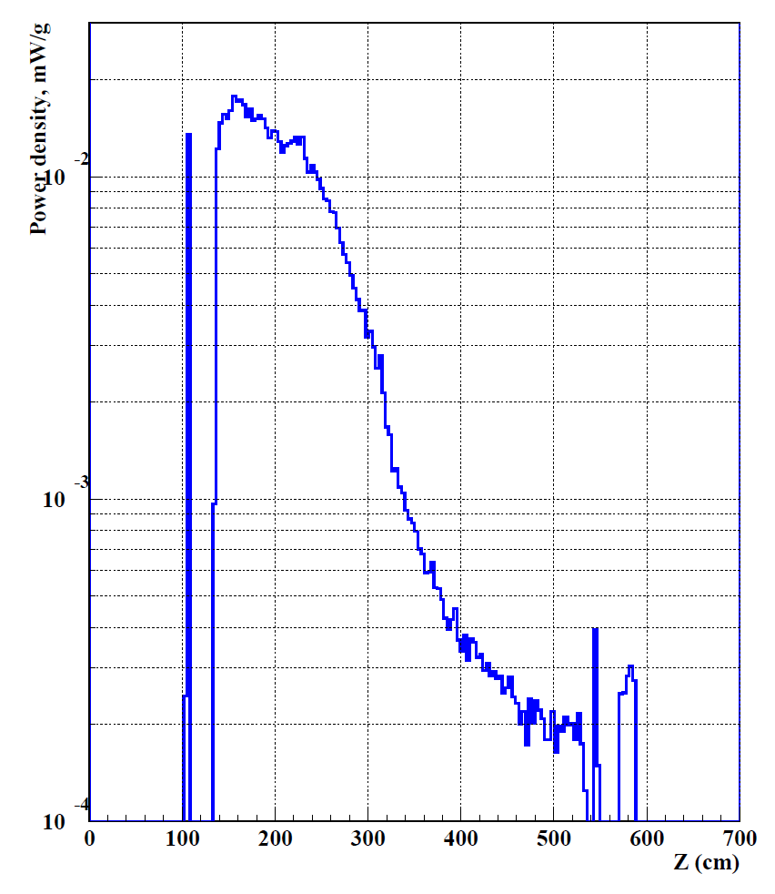
Power density, mW/g
Limit ~30 µW/g
18 µW/g
V. Pronskikh, Radiation damage, NuFact’12, July 23-28, Williamsburg

Slide 17
Summary
Quantity | MARS15 | Limits
Peak Total Neutron flux in coils, n/cm2/s | 8.3*10⁹
Peak Neutron flux > 100 keV in coils, n/cm2/s | 3.1*10⁹
Peak Power density, µW/g | 18 | 30
Peak DPA | 3.2*10⁻⁵/yr | 4-6*10⁻⁵
Peak absorbed dose over the lifetime, MGy | 1.65 | 7
Dynamic heat load, W | 20 | 100
Radiation damage is a key issue for experiments at the Intensity Frontier
Models are developed and experiments are proposed to understand and address the issue
Current Mu2e design solutions are safe during the lifetime of the experiment but more work is needed for fine tuning, value engineering and upgrade (Project X)
V. Pronskikh, Radiation damage, NuFact’12, July 23-28, Williamsburg

Slide 18
Thank you !

Slide 19
Back up slides

Slide 20
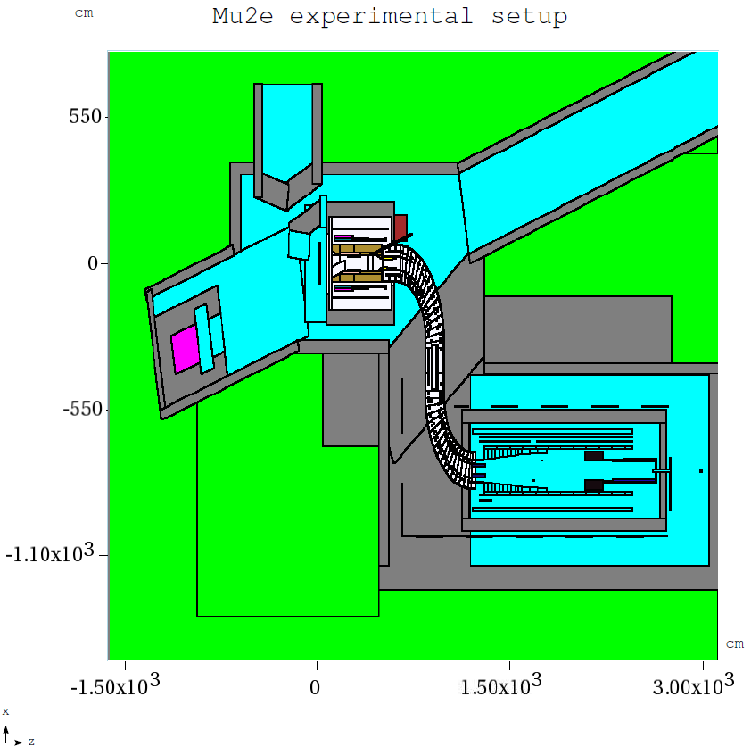
Mu2e hall MARS15 model
Production Solenoid
Transport Solenoid
Detector Solenoid
V. Pronskikh, Radiation damage, NuFact’12, July 23-28, Williamsburg

Slide 21
Mu2e Requirements. RRR vs DPA
RRR(DPA) = $\frac{ρ_{hi }^{}}{ρ_{0}+∆ρ(DPA)}$
$ρ_{hi}^{ }$ = 2.7E-6 Ω*cm
$ρ_{0}$ = $\frac{ρ_{hi }^{}}{1000}$ (Mu2e requirement)
$∆ρ$ – from KEK measurement
(RRR degradation from 457 to 245)
$\frac{ ∆ρ_{ }^{}}{DPA}$ - DPA using NRT model with
correction for defect production
efficiency $η$
Range 4-6E-5
$η=\frac{N_{D}}{N_{NRT}}$; 0.357 – 0.535
Broeders, Konobeyev, 2004
V. Pronskikh, Radiation damage, NuFact’12, July 23-28, Williamsburg

Slide 22
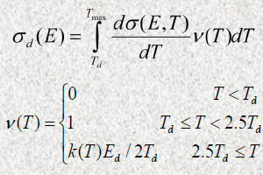
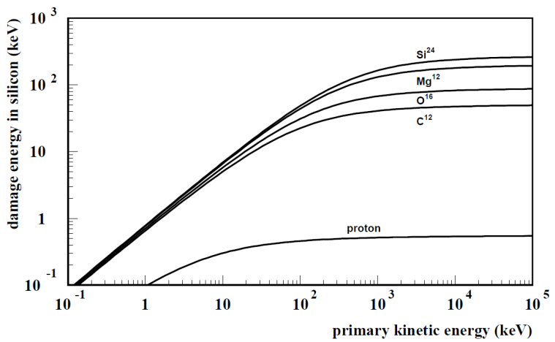
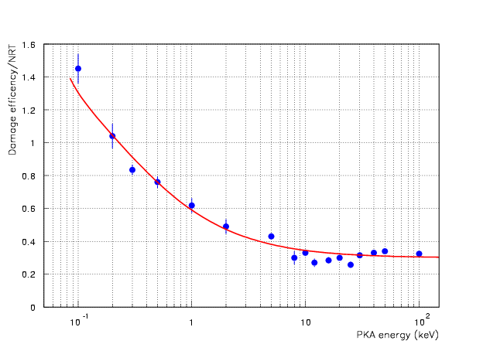
DPA Model in MARS15
Norgett, Robinson, Torrens (NRT) model for atomic displacements per target atom (DPA) caused by primary knock-on atoms (PKA), created in elastic particle-nucleus collisions, with sequent cascades of atomic displacements (via modified Kinchin-Pease damage function n(T)), displacement energy Td (irregular function of atomic number) and displacement efficiency K(T), Ed – energy to nuclear collision.
Td in Si
K(T)
M. Robinson (1970)
R. Stoller (2000), G. Smirnov
All products of elastic and inelastic nuclear interactions as well as Coulomb elastic scattering of transported charged particles (hadrons, electrons, muons and heavy ions) from 1 keV to 10 TeV. Coulomb scattering: Rutherford cross-section with Mott corrections and nuclear form factors for projectile and target. 10% agreement with FLUKA, PHITS
V. Pronskikh, Radiation damage, NuFact’12, July 23-28, Williamsburg

